Slide 1
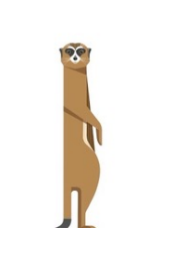
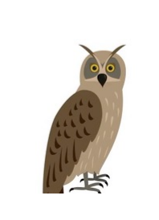
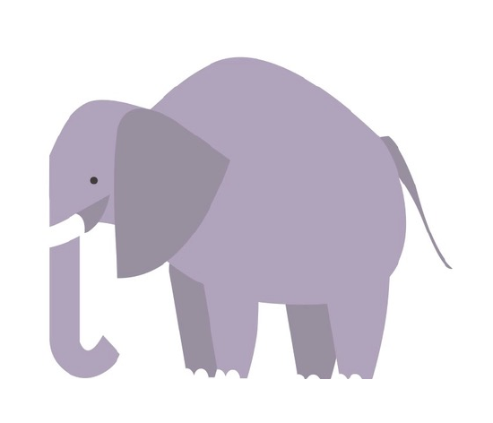
The Meerkat, the Elephant and the Owl game

Slide 2
How to play
Listen to the stories and try work out when the characters are using either;
The Meerkat
Our part of the brain that notices danger!
The Elephant
Our part of the brain that remembers things
The Owl
Our part the brain that thinks about things

Slide 3
Alex
Alex sees a spider in his house, it gives him a fright. He then remembers watching a TV program once about poisonous spiders which makes him feel even more frightened. However, he then thinks about how this TV program was not in the UK and even then it said spider bites were rare. Alex then feels calm.

Slide 4
Alex
What animal was involved when Alex saw the spider?
What animal was involved when Alex remembered the TV program about poisonous spiders?
What animal was involved when Alex thought about the other information about spiders on the program (that there are no dangerous spiders in the UK and spider bites are rare)?

Slide 5
Naomi
Naomi has got a maths test coming up. She starts to feel a bit worried about it but then remembers that she did not do too badly in the last maths test and what she did get wrong her teacher helped her with. On the morning of the test she thinks to herself “a bit of worry is fine but not to the point it makes me feel unwell” and that she is just going to do her best.

Slide 6
Naomi
Which animal was involved in Naomi worrying about the test?
Which animal was involved in her remembering she did ok last time? Was it positive?
Which animal was involved on the morning of the test?

Slide 7
Faisal
Faisal has been invited to Josh’s birthday party. Faisal was recently at Alice’s party and because there was lots of people there started feeling unwell and hot . He worries this will happen again and thinks about not going. Faisal does not feel good about letting Josh down so he tells his mum about this. His mum explains sometimes we can just feel a bit overwhelmed and that it is important he still goes to Josh’s party. Faisal decides to go to the party and despite feeling a bit uncomfortable at first has a nice time.

Slide 8
Faisal
What animal was involved when Faisal thought of Alice’s party?
What animal was involved when Faisal started thinking about Josh’s party?
What animal was involved in Faisal talking to his mum?
How many owls are in this story and where are they?

Slide 9
Well done everyone!
Remember to try and use your owls to control your Meerkats and Elephants

