Slide 1
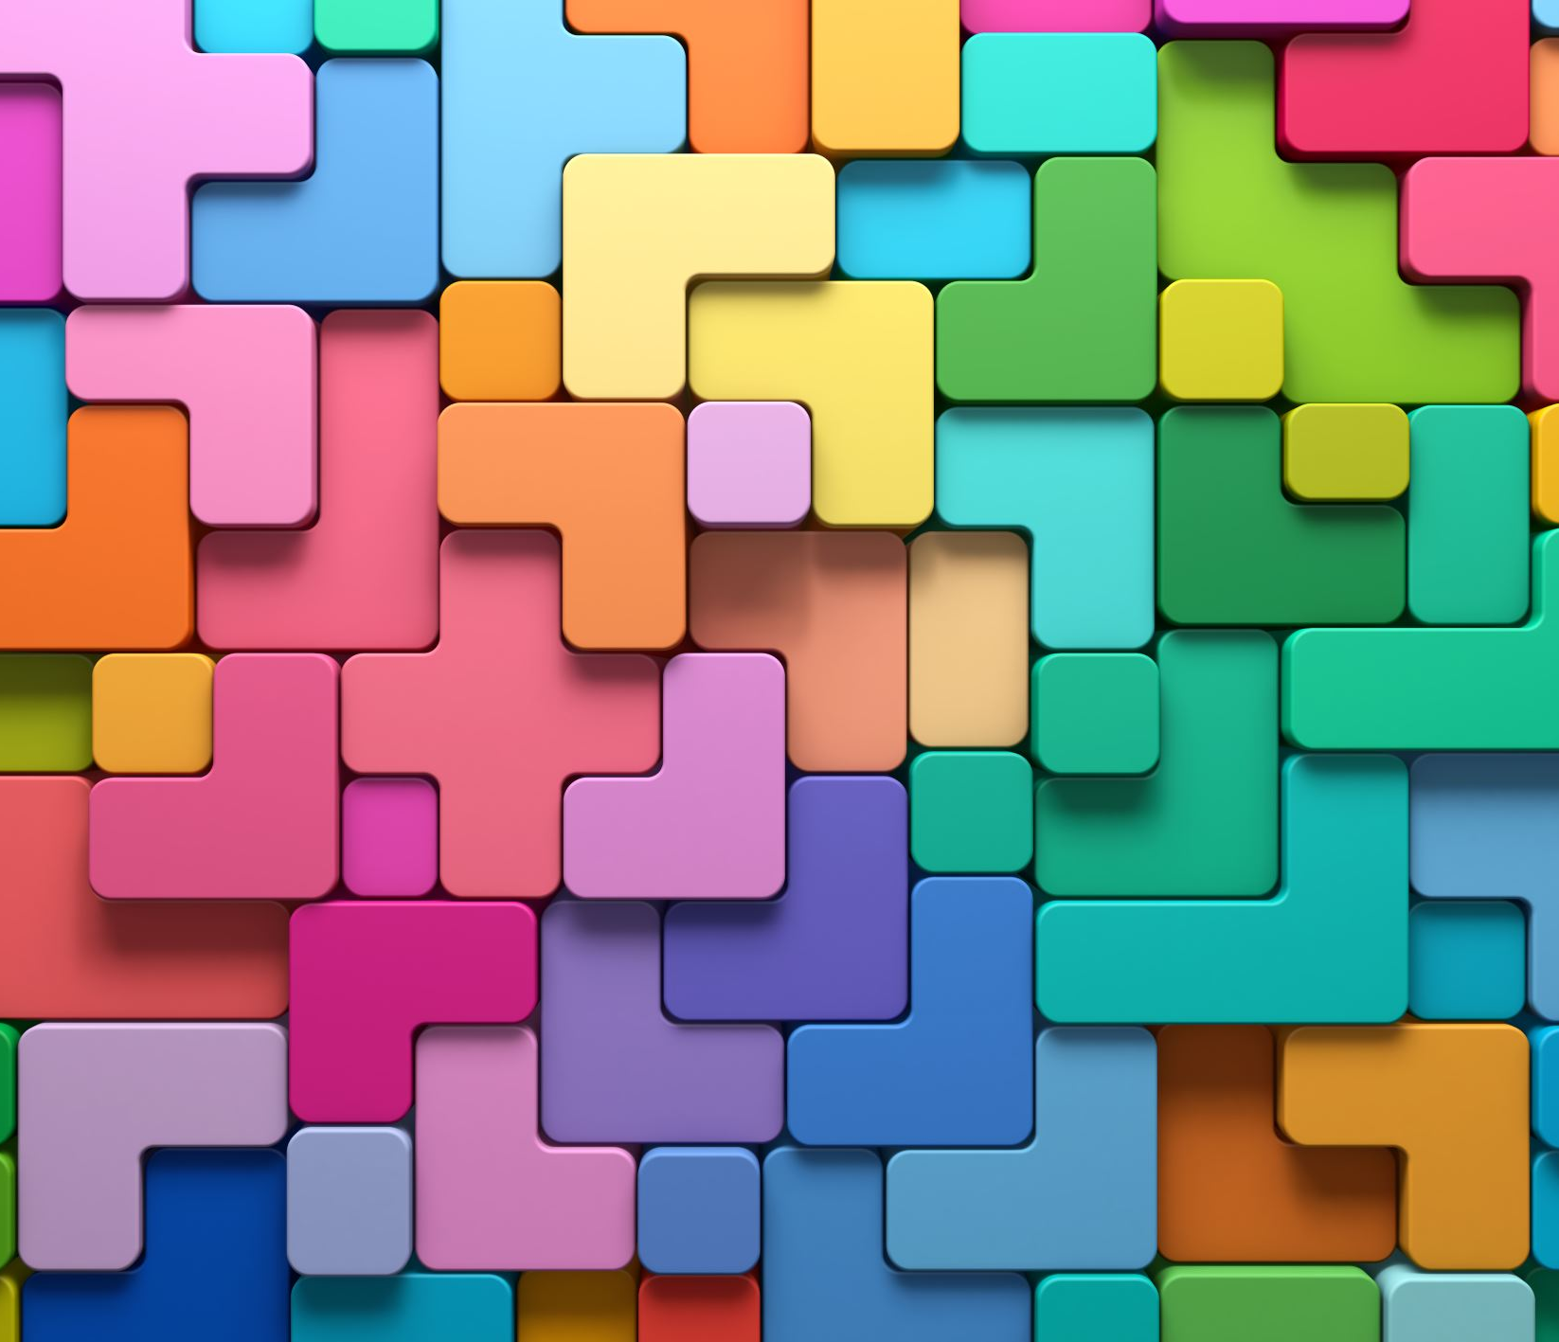

Emotions
Emotions are our body’s reaction to thoughts or experiences.

Slide 2
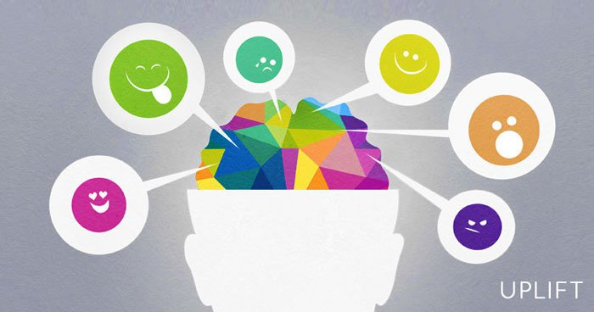
What are emotions?
Emotions are reactions our bodies have to thoughts, memories, or experiences.
They are made up of our feelings, bodily sensations, our thoughts and behaviours

Slide 3
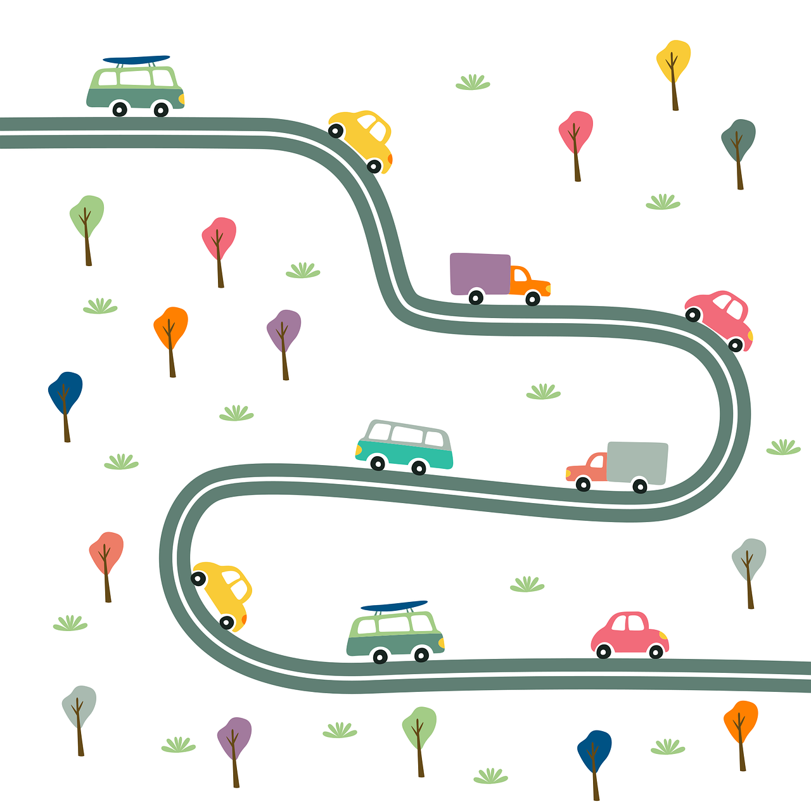
What do emotions do?
Emotions drive our actions. They…
… act as motivation
… help us avoid danger
… help us make decisions
… help others understand us better
… help us to understand others

Slide 4
Take out a piece of paper and something to write with…
… write down as many emotions that you can think of in 2 minutes.

Slide 5
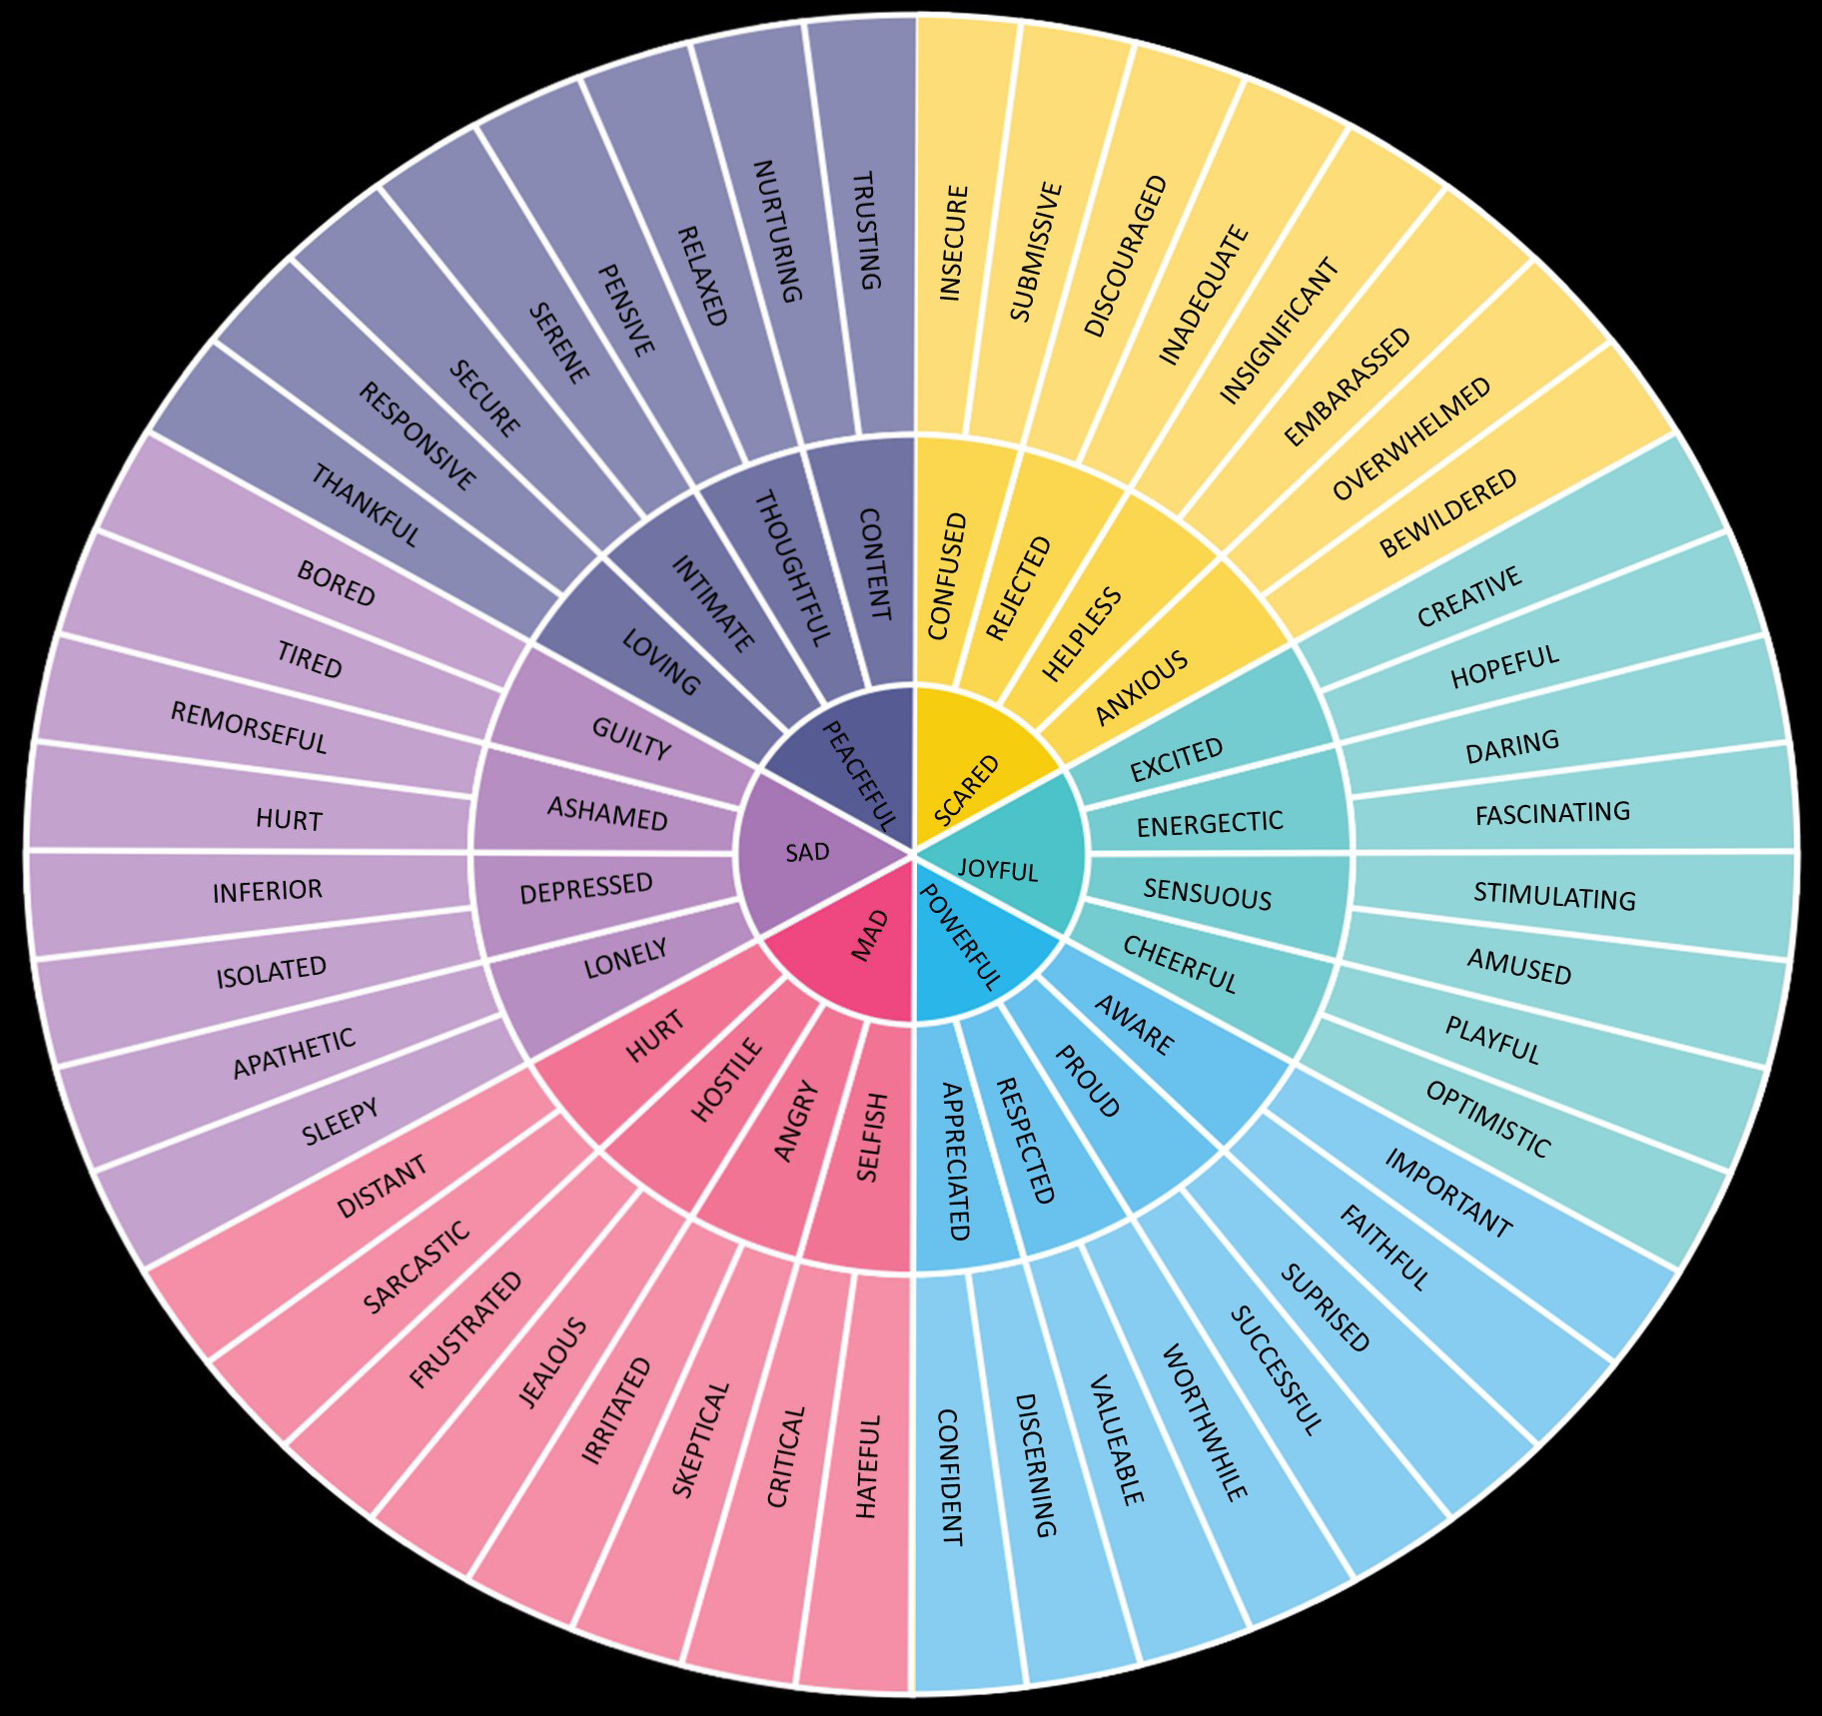
How many did you list?

Slide 6
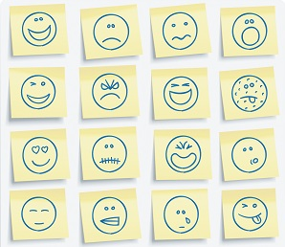
6 main emotions
Mad (angry)
Sad
Peaceful
Scared
Joyful
Powerful
What might each of these emotions look like?
What might these emotions feel like?
When might you feel these emotions?

Slide 7
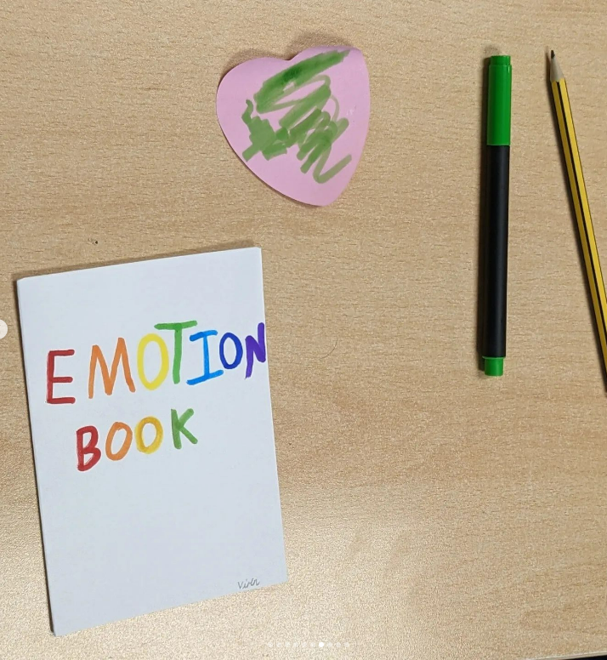
ZINES…
Make a zine using the 6 main emotions (MAD, SAD, PEACEFUL, POWERFUL, JOYFUL, SCARED) to inspire each page...
What colours do each emotion make you think of?
How does each emotion make you act?
What things make you feel each emotion?
What do you do when you are feeling this way?

Slide 8
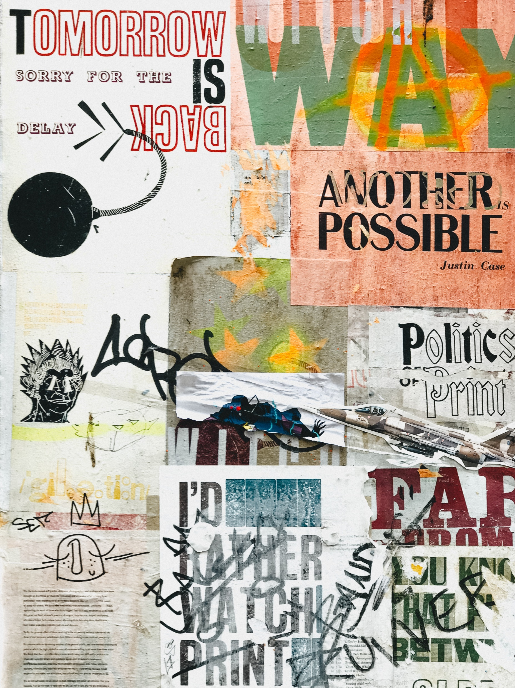
Collage zines...
Collage is an art method that is created by layering different materials using glue to make images or stories.
There are lots of ways collages can be used to make zines!
A collage zine might:
include a variety of materials including magazine clippings, ribbons, bits of coloured paper or card, tissue paper, leaves, stickers, fabric photographs or other found items
use bits text or images to tell a story throughout the zine or each page could be an individual collage

Slide 9
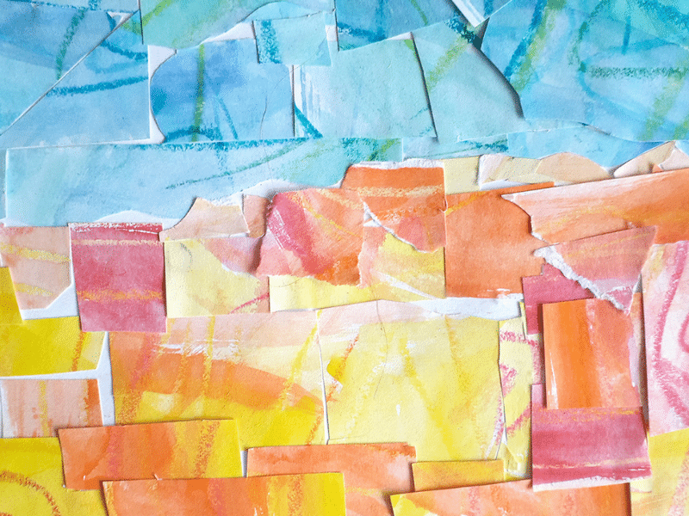
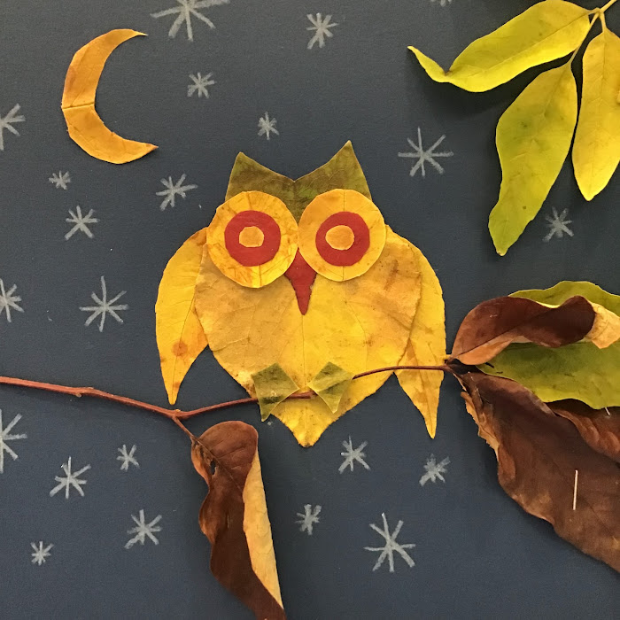
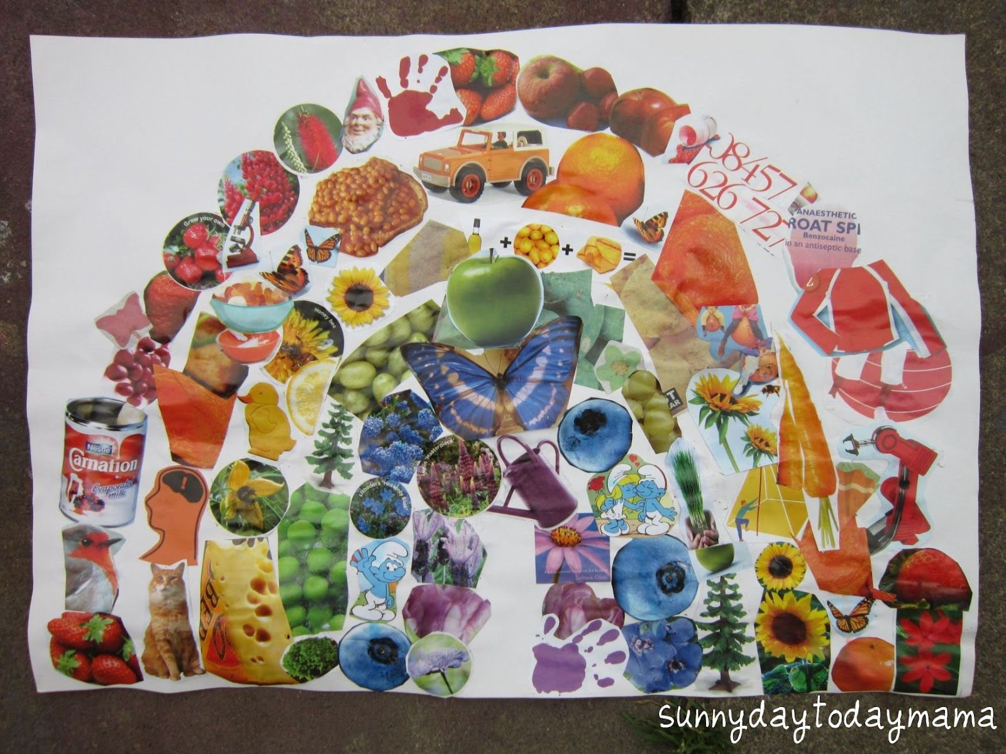
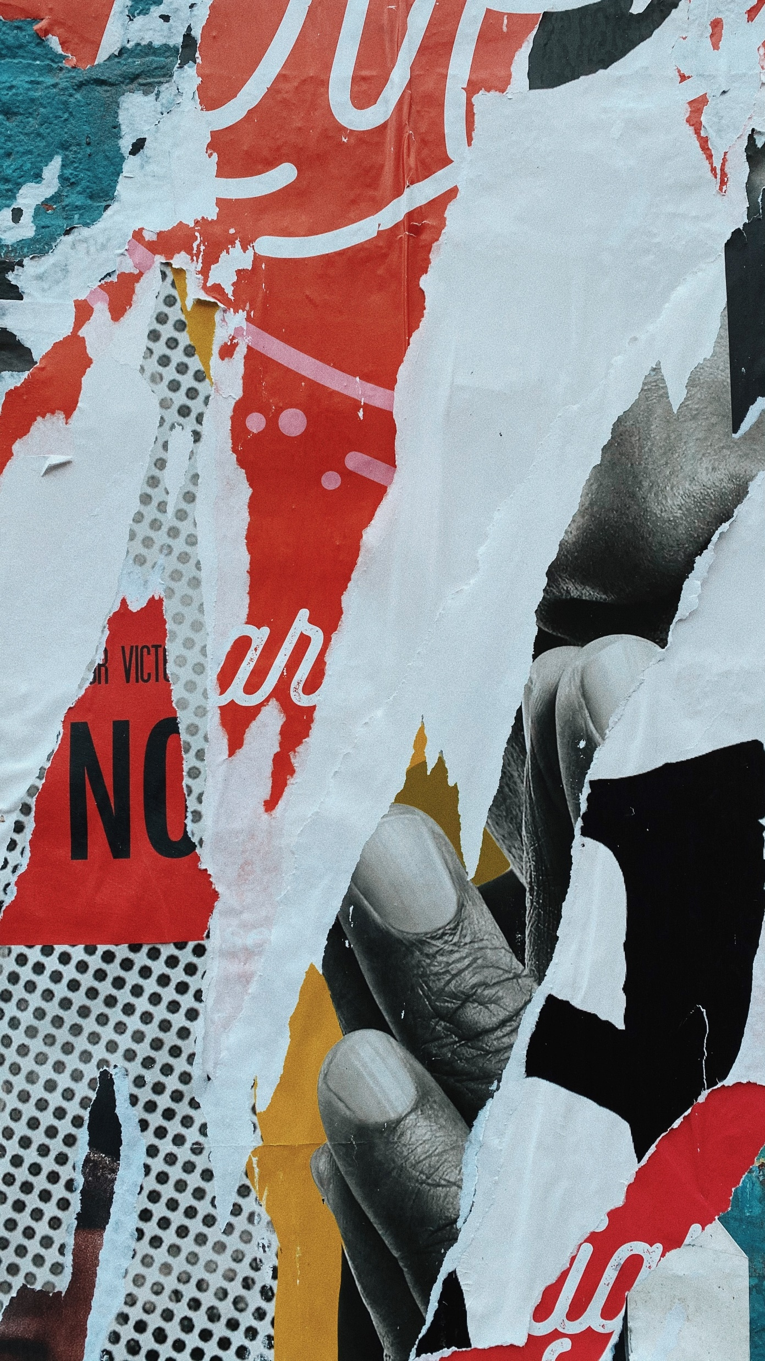
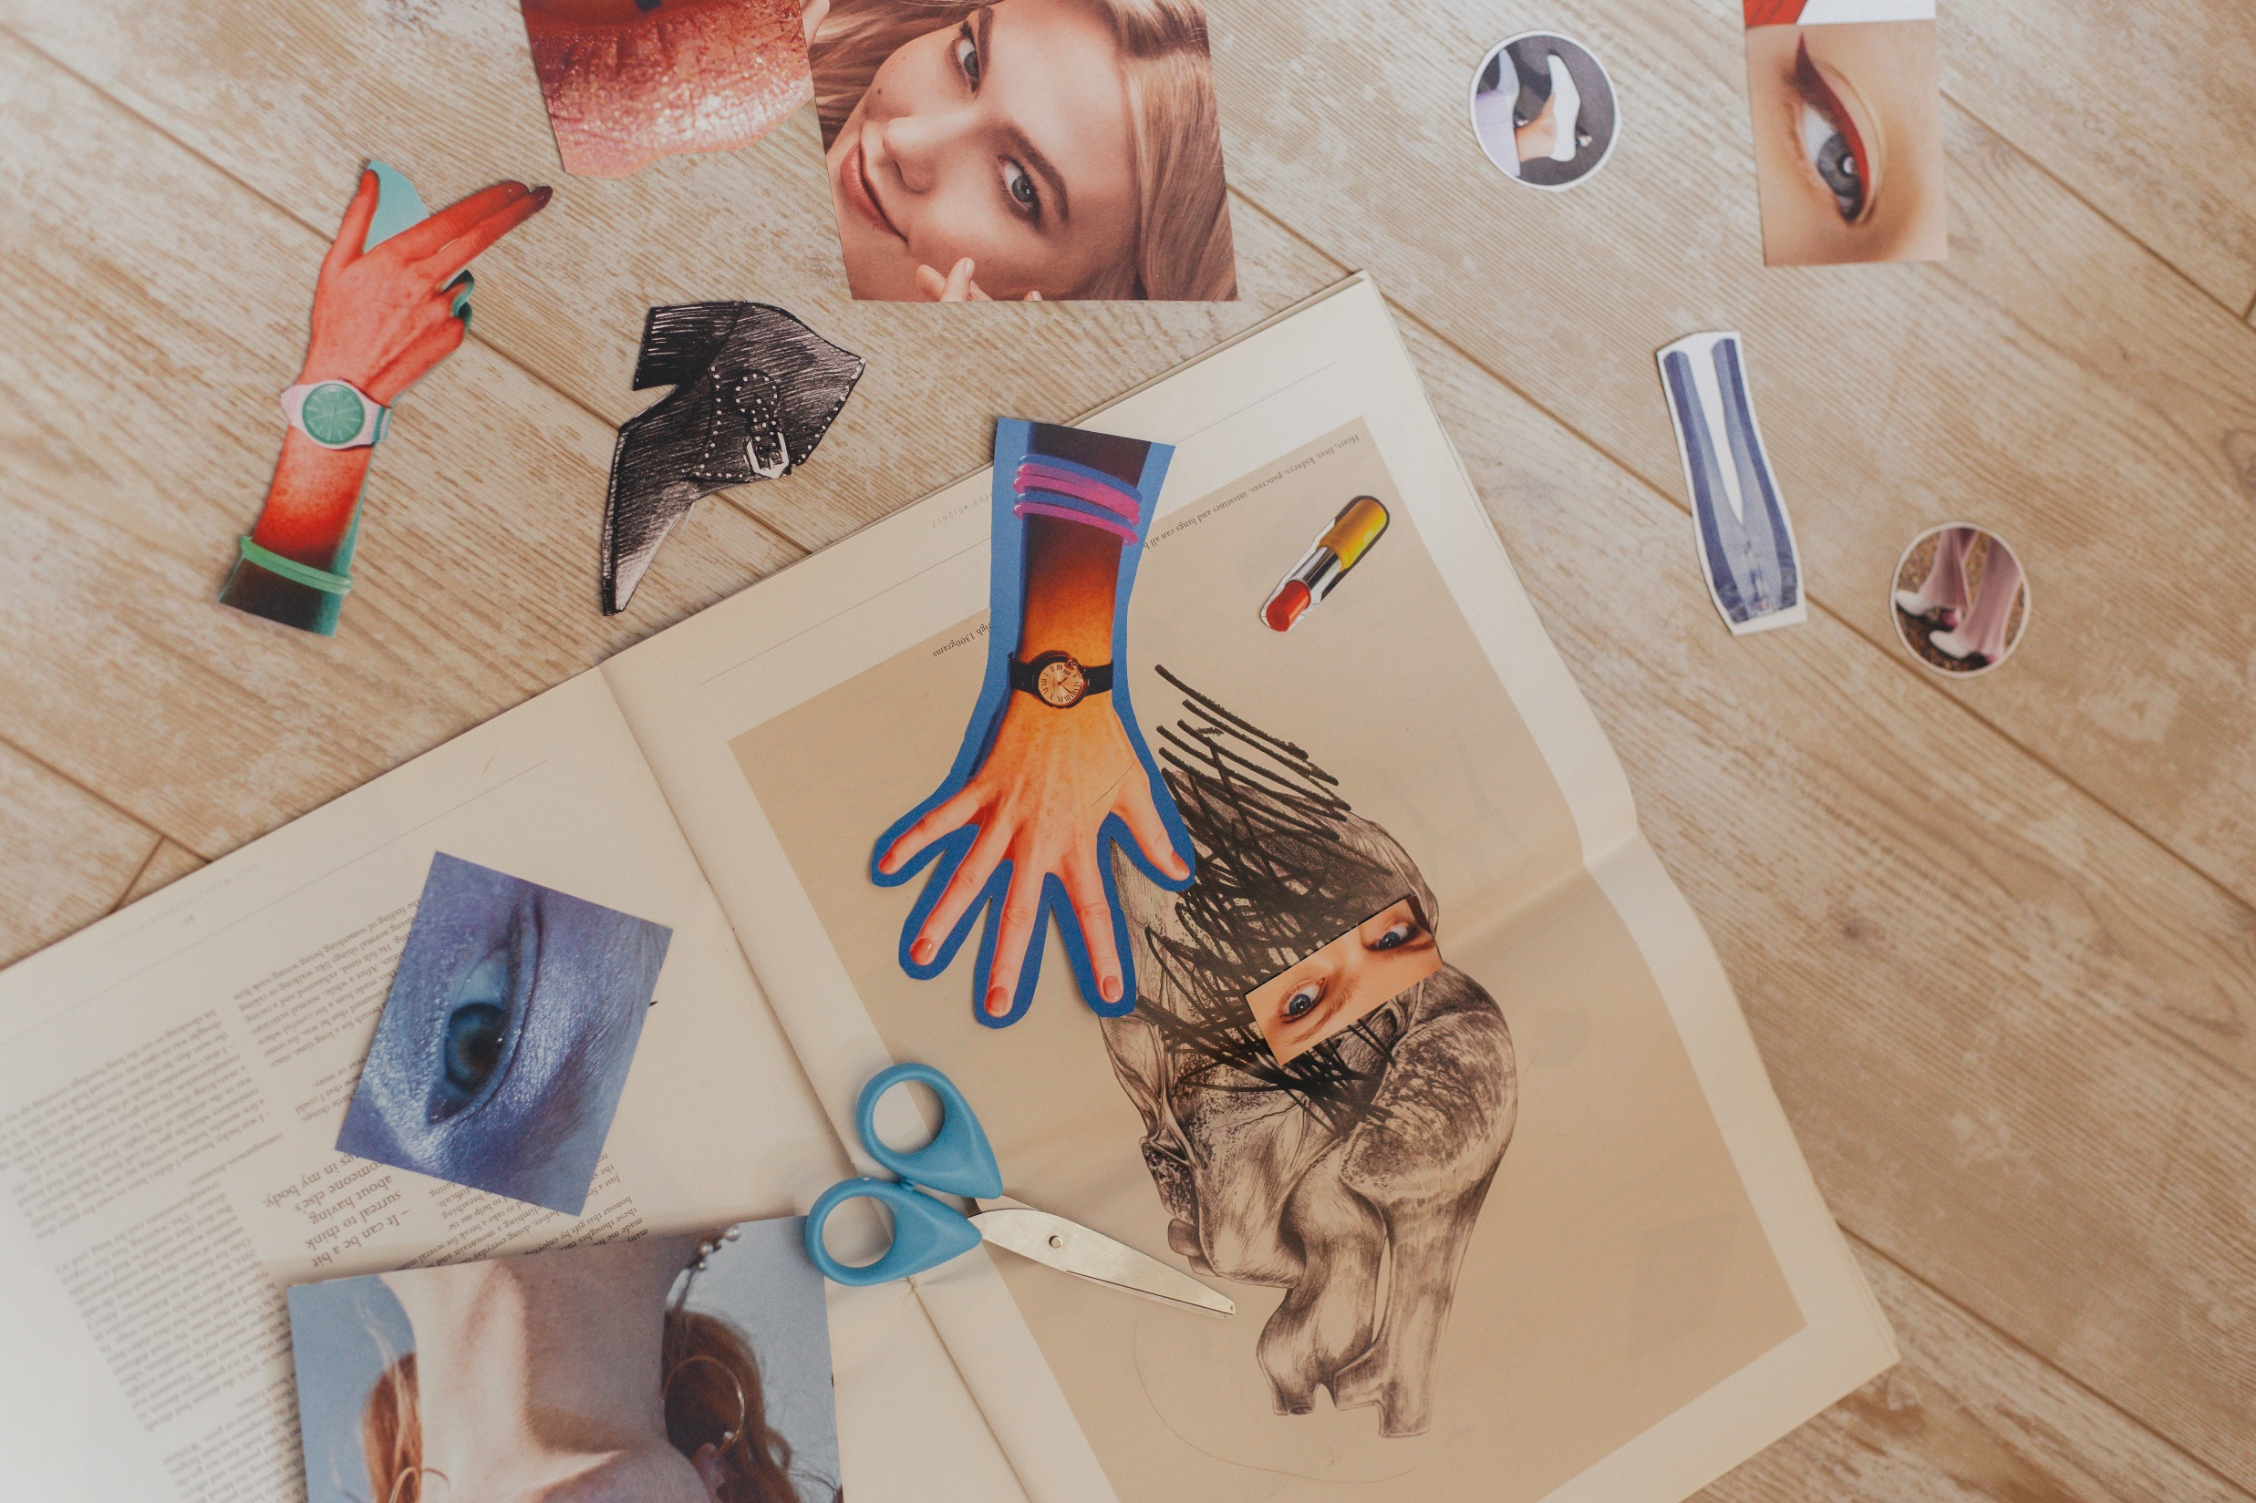
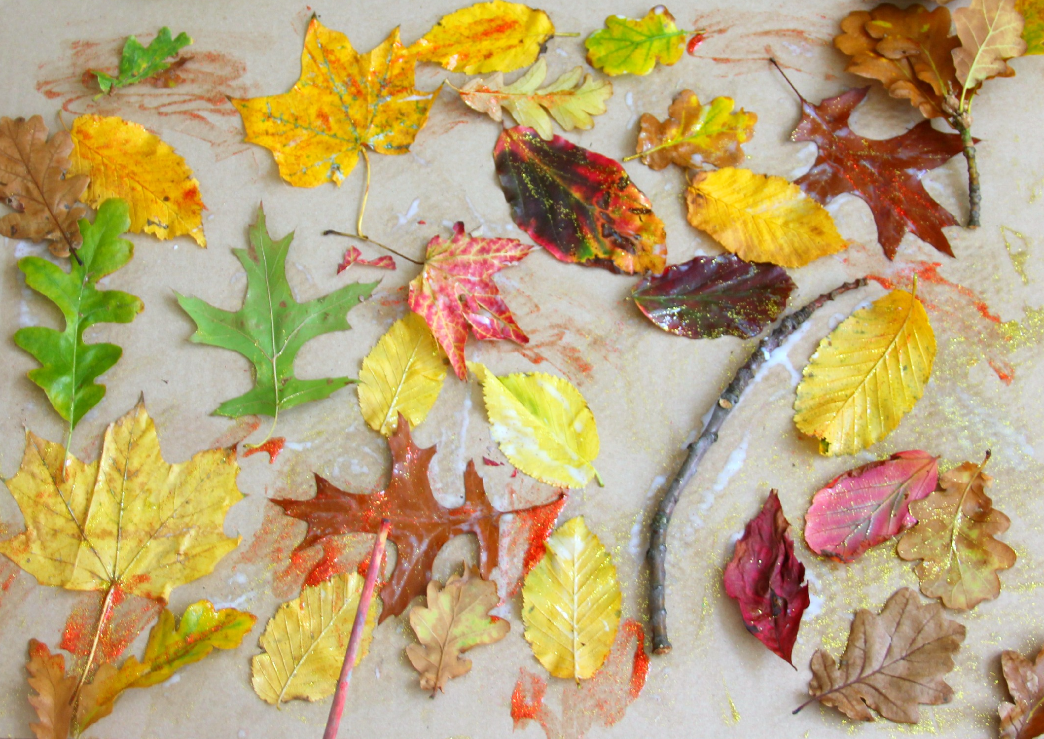
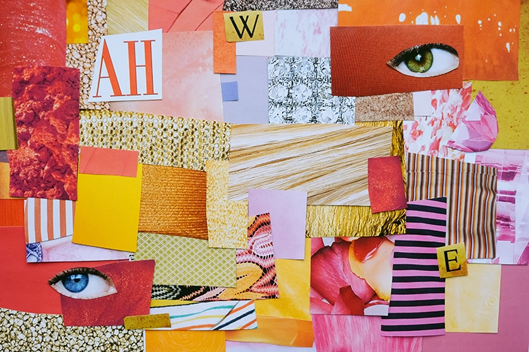
Here are some example of collages...
Can you find a way to include collage in your zine today?

