Slide 1
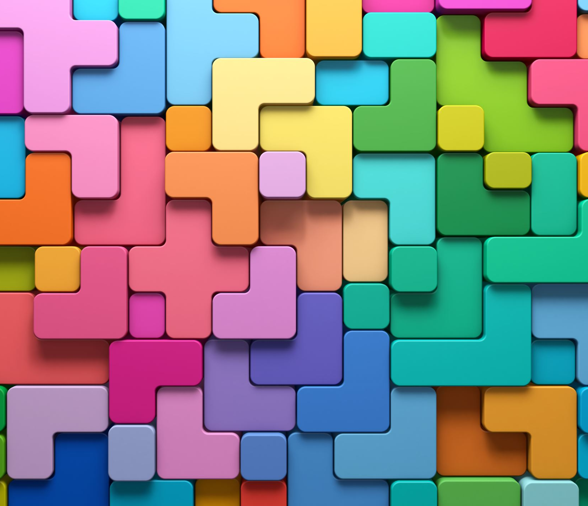

What are zines? How can they build emotional literacy?

Slide 2
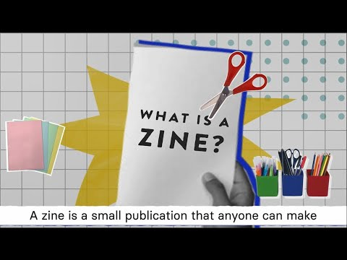
The video below will show you what emotional literacy is, what zines are and how they can fit together!

Slide 3
Take out a piece of paper and something to write with…
… in 2 minutes write down as many things you can think that
can help us be mentally healthy

Slide 4
Share some of these with the class...
Do lots of people have similar ideas?
Were there any ideas that surprised you?
Some ideas might include:
self-esteem, positive relationships with others,
good night sleep, spending time with others, doing activities we enjoy, talking to people, taking time for ourselves

Slide 5
More about ZINES…
Some people use zines to express their feelings and help work through different emotions and practice responses in situations, some use them to talk about things they enjoy (or don’t enjoy) doing. Sometimes people share these with others, and sometimes they keep them to themselves and refer back to them if they need to...

Slide 6
Now it's your turn....
Take 2 pieces of paper...
Stack one piece on top of the other...
Fold both sheets in half (short edges together)…
Put two staples along the folded edge...
Now you have a blank zine...

Slide 7
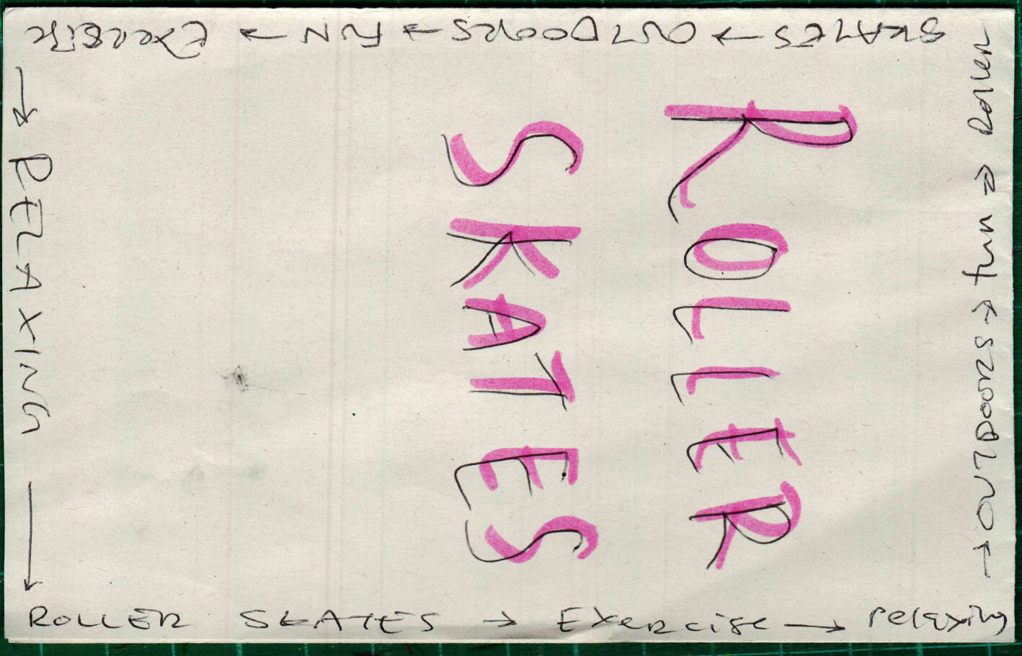
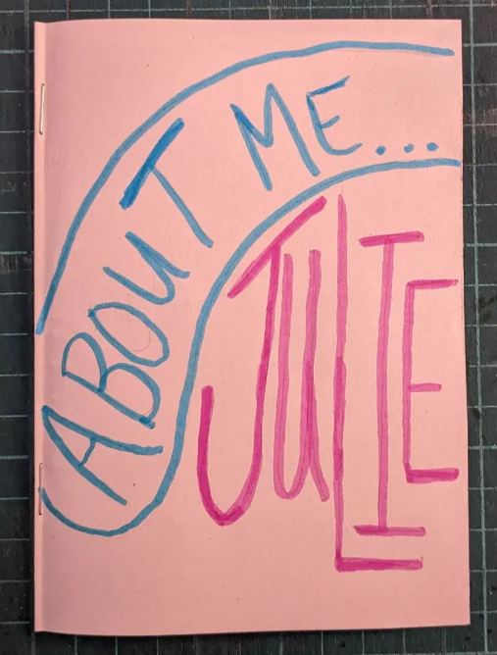
Make your zine...
Make a speed zine (about 2 minutes per page) about:
one thing you want others to know about you and why!
This could be:
a favourite vegetable (and WHY)
your favourite thing to do
Your favourite game
Your favourite TV show
any other topic that you'd like people to know about
or try to make one page about something for each letter of your name!

