Slide 1


Emotional Regulation
Emotional regulation is our ability to control our emotions.

Slide 2
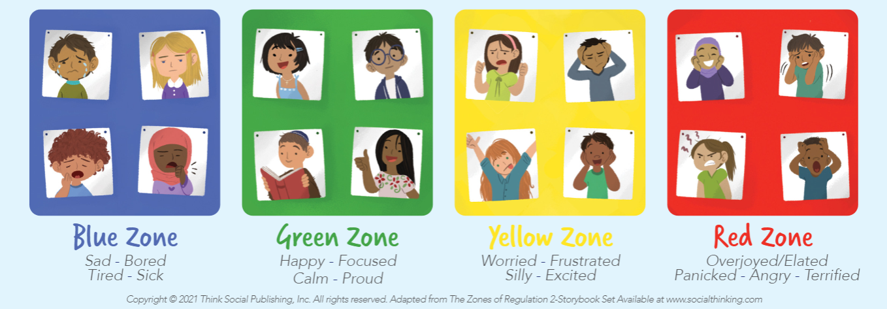
One way to think about this is to look at the Emotional Zones and think about how we could move from one emotional zone to another…

Slide 3
Blue Zone
Green Zone
low or ‘down’ feelings
calm feelings
Happy – Focused – Content
Proud - Ready to learn
Sad - Tired - Sick - Bored
Yellow Zone
Red Zone
slightly elevated feelings
extreme feelings
Worry – Frustrated – Silly
Excited - Stress
Overjoyed – Panicked – Anger
Terrified - Devastated

Slide 4
Mariah has caught a cold and has to stay home from school. She has been at home for two days and feels sad as she is missing out on playing with her friends at school. She has to stay in bed so that she can recover but she is bored which is making her sadder.
What emotional zone is Mariah in?

Slide 5
BLUE

Slide 6
Amber is walking home after school and she sees a big dog barking at another dog. Amber starts to panic and she freezes on the street and doesn’t want to move.
What emotional zone is Amber in?

Slide 7
RED

Slide 8
Michael plays football and this weekend scored the winning goal for his team. He is feeling very happy and proud of what he did and is feeling focused and ready for the next week.
What emotional zone is Michael in?

Slide 9
GREEN

Slide 10
Shanice and Mohammed are drawing in class. Shanice is getting worried because she hasn’t finished her drawing yet and it is nearly home time. She tries to rush to finish it but ends up tearing the paper which makes her very frustrated. Mohammed on the other hand is having fun drawing and is excited about all the different colors he gets to use.
What emotional zone is Shanice in?
What emotional zone is Mohammed in?

Slide 11
YELLOW

Slide 12
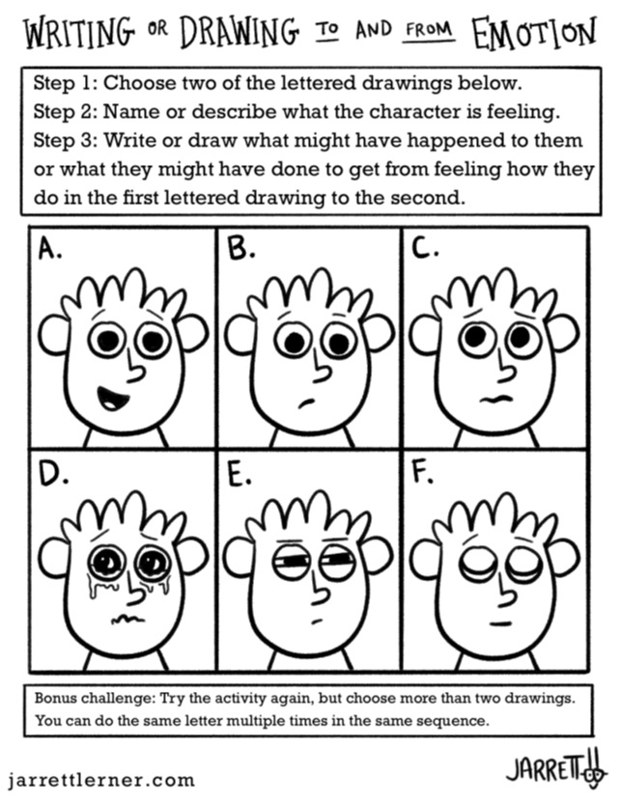
ZINES…
Tell the story about a person or character who is feeling one of the feelings that is in your assigned emotional zone…
How are they feeling?
Why do they feel that way?
What can they do to get back to the Green zone?
What could other people do to help them move back into the Green zone?

Slide 13
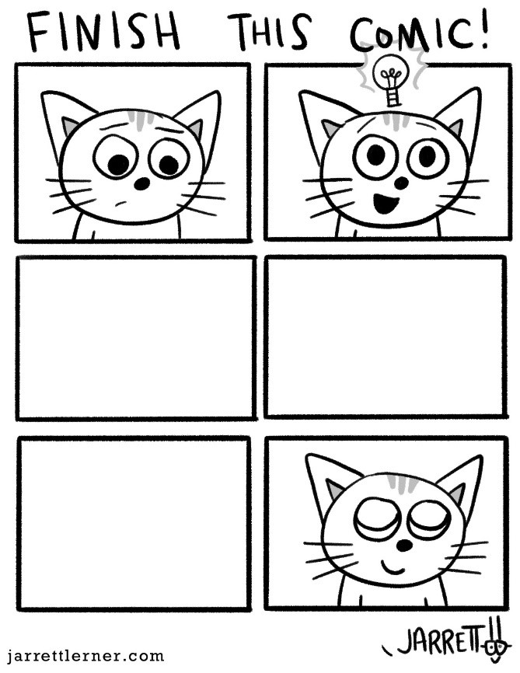
Comics…
Comics are a form of art that includes images and are often combined with text. They are one of the most common things in zines!
A comic zine might:
Include just drawings or could include text in speech bubbles or as captions.
Have each page as one drawing or have different sections across one page; known as a comic panel
Be coloured or left as a line drawing.

Slide 14
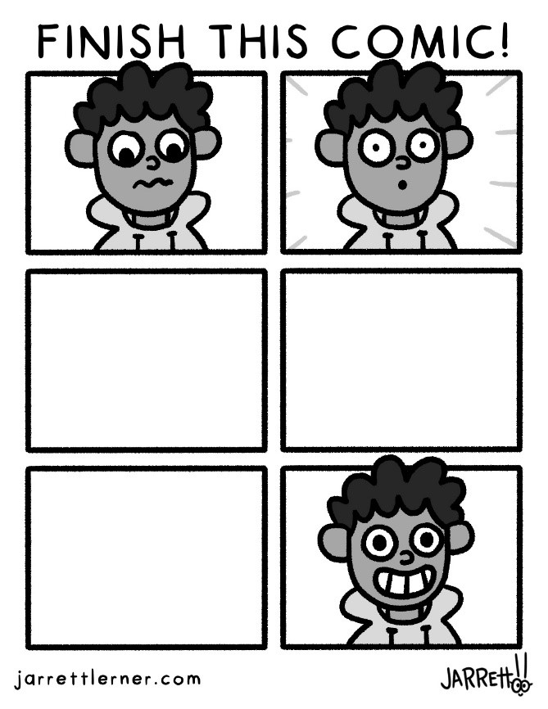
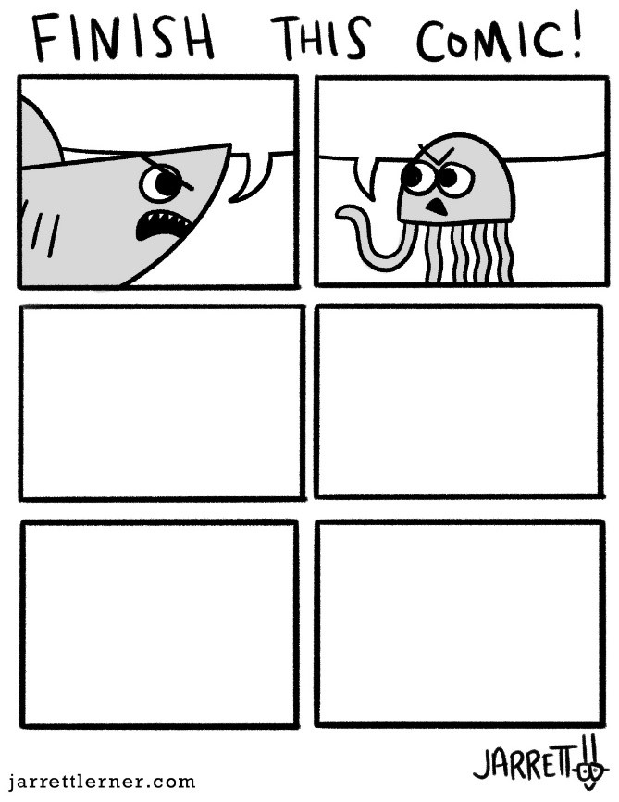
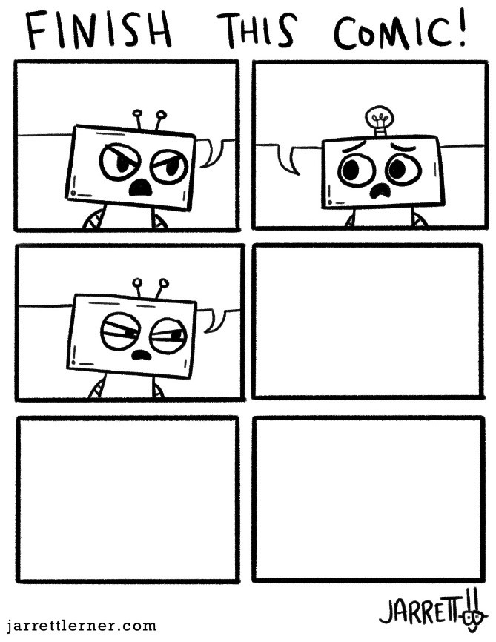
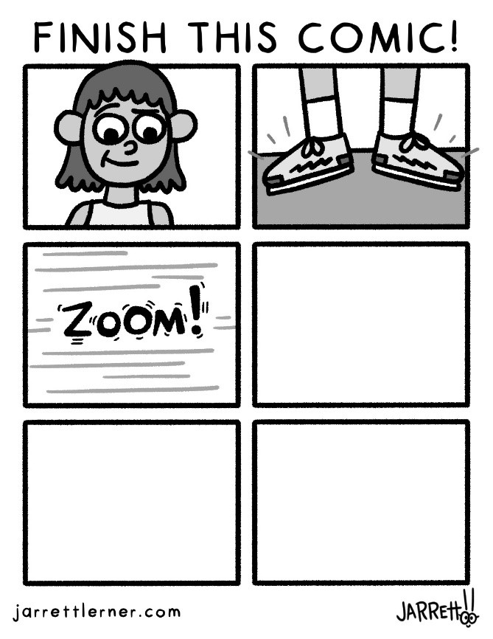
Here are some partially complete comic pages borrowed from an artist called Jarret Lerner.
Can you find a way to include comics in your zine today?

