Slide 1


Stress
Stress is our body’s reaction to a perceived threat.

Slide 2
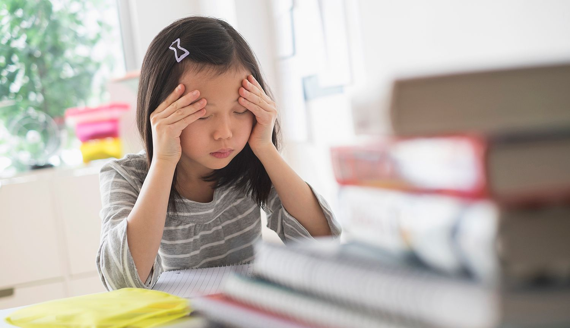
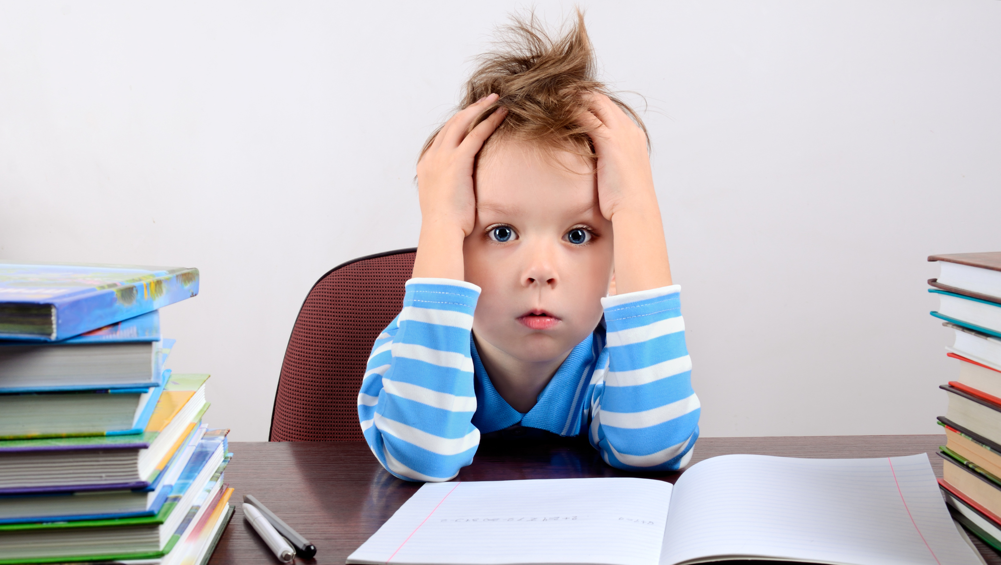
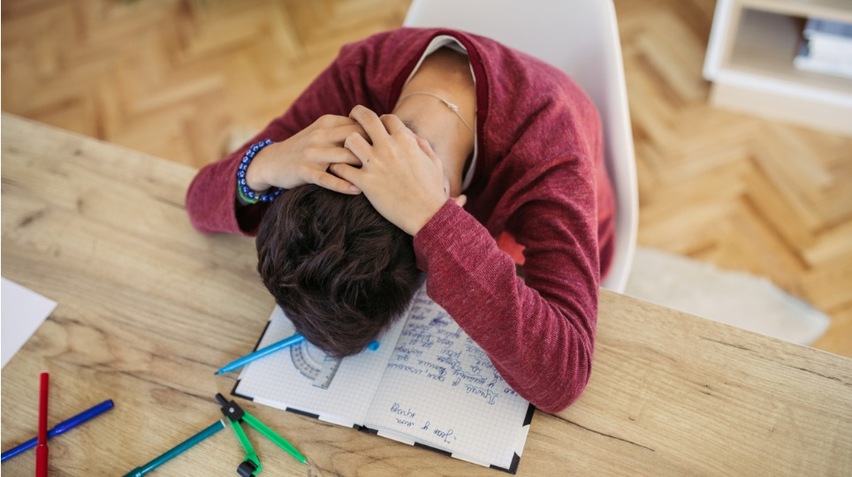

How might stress feel?
Struggling to pay attention
Blurred vision
Headache
Not being hungry
Echoing sounds
Flushed cheeks
Shortness of breath
Dry mouth
Upset tummy / butterflies
Sweaty hands / feet
Shakey hands
Heart pounding
Trouble sleeping
Struggling to regulate emotions
Stiff Legs
Feeling agitated

Slide 3
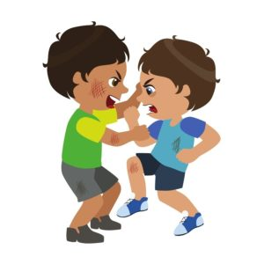
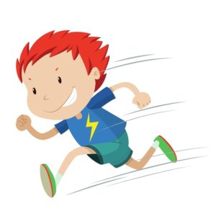
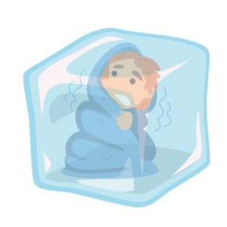
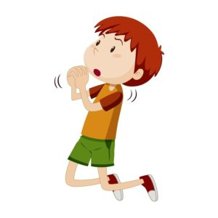
When confronted with a stressful event, your body triggers a response that increases your heart rate and blood pressure and heightens senses.
This response is called the Stress Response and there are 4 types:
Fight
Flight
Freeze
Fawn
Shouting
Screaming
Hitting
Throwing
Kicking
Blaming
Aggression
Wanting to leave
Running away
Fidgeting
Avoiding
Distracted
Restless
Wanting to hide
Want to be invisible
Can’t find the words
Daydreaming
Blank mind
Becomes silent
Sits still
Pleasing others
Difficulty saying no
Gives into pressure
Agreeing with others
Saying sorry

Slide 4
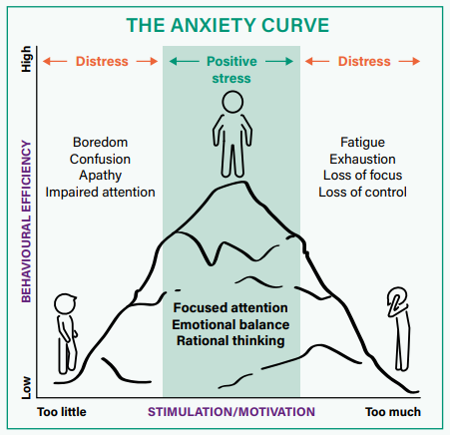
Surprisingly, the right amount of stress can be good!
Too little stress can result in boredom or not paying attention
Too much stress can lead to exhaustion, panic, or anger

Slide 5
Alex does not want to go to school today. He has not finished his homework because he found it hard to complete. He is pretending that he is sick so that he doesn’t have to go into school at all.
Is Alex stressed?
Which stress response is Alex using?

Slide 6
What could help Alex feel less stressed?
YES, Alex is stressed.
He is showing the Flight stress response.

Slide 7
Sharna has started a new school and is making new friends easily and understands all the lessons. She loves her new classmates and teachers and looks forward to attending every day.
Is Sharna stressed?
What stress response is Sharna using?

Slide 8
What might have made Sharna feel stressed?
What might her stress responses be?
NO, Sharna is not stressed.

Slide 9
Every time James wants to say something in class someone else talks over him, not giving him the chance. He feels that he is not being listened to and it makes his chest feel tight every time it happens. He has decided to just let other people talk in class and to stop raising his hand to answer.
Is James stressed?
Which stress response is James using?

Slide 10
What could help James feel less stressed?
YES, James is stressed.
He is showing the Fawn stress response.

Slide 11
Aminah has some exams coming up and she did not get the grade that she wanted on the last test. She has been thinking about it nonstop all week. She has been having trouble sleeping and has a headache. Every time she tries to study, her mind goes blank and she cannot focus.
Is Aminah stressed?
Which stress response is Aminah using?

Slide 12
What could help Aminah feel less stressed?
YES, Aminah is stressed.
She is showing the Freeze stress response.

Slide 13
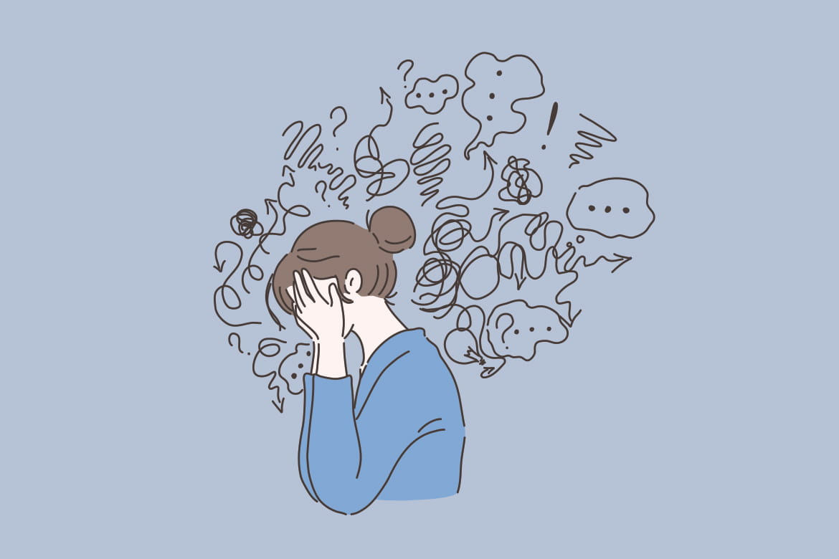
ZINES…
Make a zine telling a story about feeling stressed at school. This can be a time that you felt stressed or a story about a character who feels stressed at school...
How does it feel?
How to move past it?
Who to ask anyone for help?
What could have made it easier to cope with the stress?

Slide 14
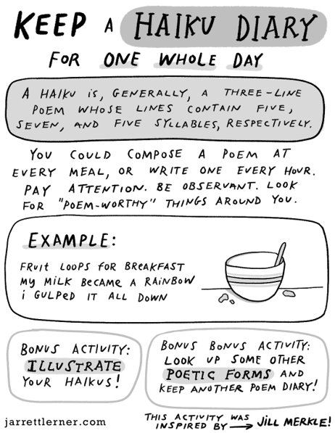
Poetry zines...
Poetry can often be a way to get thoughts down in a structured way.
There are lots of different types of poetry and lots of ways to use these in your zines!
A poetry zine might:
include a small collection of poems, or one poem spread, line by line across different pages
include illustrations or pictures, or it might just be text
be your own words, or be words borrowed from someone else that fit your feelings

Slide 15
Here are some poems we have written / borrowed about stress!
  So overwhelmed
  Trying to get everything done
  Roadblocks preventing me from finishing all my tasks
  Everyone on my back
  Stomach pains and headaches
  Someone help me finish everything!
  Out of my control,
  Racing thoughts,
  No off switch
  Take a breath,
  Slow things down,
  Take time to relax.
  When I'm stressed
  I find it hard to do my best
  To calm down my body
  I place my hands on my chest
  I take a deep breath
  and try, try again.
  Head pounding, stomach hurts
  Can't think straight, try to focus
  I think this is stress!
Can you find a way to include some poetry in your zine today?

