Slide 1




Promoting Positive Mental Health in Children and Young People from Ethnic Minority Communities
Staff Training

Slide 2
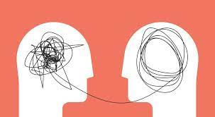
Who We Are!
Mental Health Support Team
Our job is to support young people with anxiety, low mood, anger and general mental wellbeing.
We support young people in school through 1-1 work, group work, workshops and assemblies.

Slide 3

Aim
The aim of this training session is to:
Raise awareness of the inequalities in mental health that individuals from Ethnic Minorities experience.
Develop a better understanding of additional barriers to accessing support with mental health that individuals from Ethic Minorities face.
Empower staff to feel more confident in supporting children, young people and families.

Slide 4
Confidentiality Agreement
Share with care
Respect each other
Talk to us
Right to challenge/question- but question the content not the person.
Notes:
Share with care- please if you want to share any examples anonymise information.
This training has plenty of room for your thoughts and opinions. Please share your experiences.

Slide 5
Terminology
The term BAME is no longer recommended as this unhelpfully groups many different people together and can mask dipartites between different ethnic groups (UK Commission on Race and Ethic Disparities, 2021).
Different people relate better to different terms therefore it is best to ask your pupils and students how they would like to be referred as. You may find it difficult or uncomfortable to have these conversations due to the fear of offending or upsetting people. However, it is crucial that we have an open discussion about this to help break down barriers.
For purpose of this training the term Ethnic Minority Communities will be used, specifically focusing on those from Black, Asian and Mixed Ethnic backgrounds.
Notes:
More guidance about terminology can be found- https://www.ethnicity-facts-figures.service.gov.uk/style-guide/writing-about-ethnicity

Slide 6
Initial Check-in Questions
How much do you know or understand about mental health in Ethnic Minority Communities?
How confident and comfortable do you feel about talking to children, young people and their families from Ethnic Minority Communities about their mental health?
What barriers are faced when speaking about mental health in Ethnic Minority Communities in your school?
What is something you would like to get out of the training?
Notes:
Give staff 5 minutes to discuss these questions then feedback as group.
Put answers of scale from 0 to 10.

Slide 7
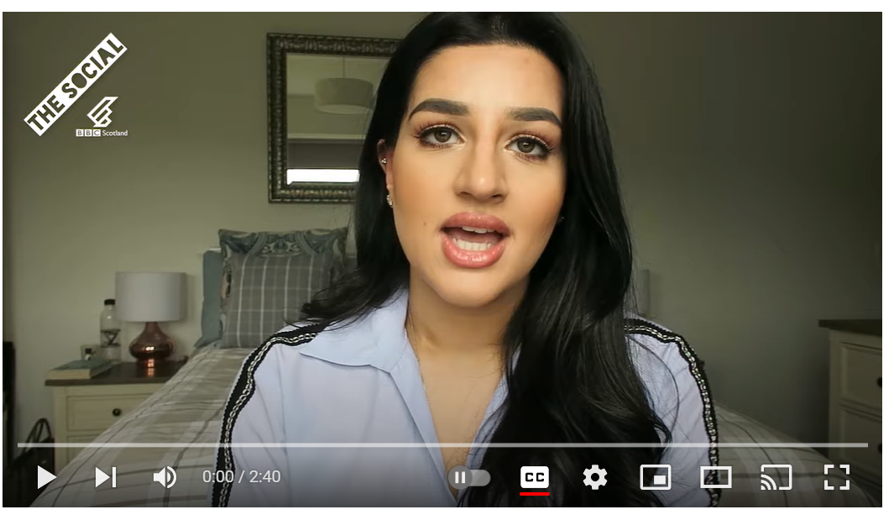
Why Are We Talking About This?
https://www.youtube.com/watch?v=2ZZxtbTJmHQ
Notes:
Play video that talks about personal experience of mental health from member of Ethnic Minority Community. Video is 2 minutes 40 seconds
Additional case studies can be found here: -https://www.themix.org.uk/mental-health/mental-health-treatments/black-peoples-experiences-of-mental-health-services-25781.html

Slide 8
Birmingham’s Population*
Ethnic Group | Percentage
White (British, Irish, Traveller or Other) | 48.7%
Asian (Indian, Pakistani, Bangladeshi, Chinese, British or Other) | 31.0%
Black (African, Caribbean, British or Other) | 10.9%
Mixed or Multiple Ethnic Groups | 4.8%
Any other ethnic group | 4.6%
*Figures from 2021 Census
Notes:
Birmingham is a very diverse city with individuals from a range of cultures so it is important to be able to have conversations about everyone's mental health. However, this can feel uncomfortable when you are not a member of the community. The training today aims to help improve confidence and give advice of best practise when supporting Ethnic Minority Communities with their mental health.
For more information see -https://www.birmingham.gov.uk/info/20057/about_birmingham/1294/population_and_census/5

Slide 9
Important Statistics
Younger and Older South Asian females have been found to more at risk of suicide (Mental Health UK and Institute of Race Relations).
Black females are more likely to experience common mental health disorders such a anxiety and depression (Rethink and Institute of Race Relations).
Black males are more likely to experience pyschosis (Rethink and Institute of Race Relations).
Refugees and Asylum seekers are more likely to experience poor mental health (Institute of Race Relations).
A disproportionate number of people from Ethnic Minority Communities are detained under the Mental Health Act (Mind).
Notes:
Statistics taken from:
https://www.centreformentalhealth.org.uk/sites/default/files/2022-04/CentreforMH_inequalities_factsheet_YPfromracialisedcommunities_1.pdf
https://www.mind.org.uk/about-us/our-strategy/becoming-a-truly-anti-racist-organisation/facts-and-figures-about-racism-and-mental-health/#:~:text=Black%20and%20Black%20British%20women,British%20White%20women%20(16%25).&text=People%20from%20Black%20and%20Minority,diagnosed%20with%20a%20psychotic%20disorder
https://irr.org.uk/research/statistics/health/
https://mentalhealth-uk.org/black-asian-and-minority-ethnic-bame-mental-health/

Slide 10
Yet…
More white people receive treatment for mental health issues than people from Black, Asian and Minority Ethnic Communities and they have better outcomes post treatment (Mental Health UK).
Children and Young People from Ethnic Minority Communities are less likely than their white peers to access traditional mental health services (Centre for Mental Health).
Children and Young people from Ethnic Minority Communities reported feeling less recognised and understood when talking to their GP about their mental health needs compared to their white counterparts (Centre for Mental Health).
Notes:
Members of Ethnic Minority Communities are more likely to access mental health support from alternative services such as their religious or faith group or the charity sector. While this can be positive, it can also create more divisions and make it more difficult to access traditional mental health services such as the NHS due to the lack of inclusivity and understanding from some of these services.
Statistics taken from:
https://www.centreformentalhealth.org.uk/sites/default/files/2022-04/CentreforMH_inequalities_factsheet_YPfromracialisedcommunities_1.pdf
https://www.mind.org.uk/about-us/our-strategy/becoming-a-truly-anti-racist-organisation/facts-and-figures-about-racism-and-mental-health/#:~:text=Black%20and%20Black%20British%20women,British%20White%20women%20(16%25).&text=People%20from%20Black%20and%20Minority,diagnosed%20with%20a%20psychotic%20disorder
https://irr.org.uk/research/statistics/health/
https://mentalhealth-uk.org/black-asian-and-minority-ethnic-bame-mental-health/

Slide 11
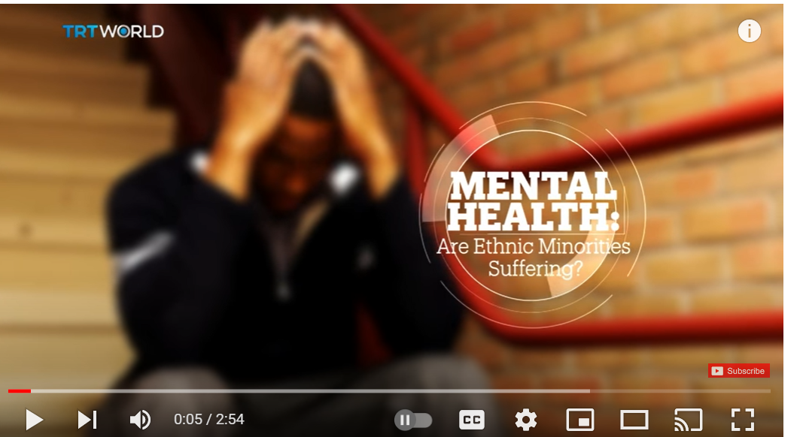
Common Barriers Experienced
https://www.youtube.com/watch?v=hu0pgasAssg
Notes:
Watch the video and discuss thoughts on what raised. Video is 2 minutes 55 seconds

Slide 12
Common Barriers Experienced Continued
Wealth and Living Standards Inequalities
Bias, Discrimination and Racism
Cultural Barriers
Language Barriers
Stigma
Lack of Publicity of Support Services
Stereotyping
Lack of Professional Understanding
Notes:
Summary of common barriers.
For more information please see-https://www.rethink.org/advice-and-information/living-with-mental-illness/wellbeing-physical-health/black-asian-and-minority-ethnic-mental-health/ and https://mentalhealth-uk.org/black-asian-and-minority-ethnic-bame-mental-health/

Slide 13
Starting The Conversation
Be open minded and consider the implications of Spirituality and Cultural Beliefs.
Listen to the experiences members of Ethnic Minority Communities are sharing rather than telling them what you think their experience is.
Rather than trying to relate, focus of being a safe space for them to offload and share how they are feeling.
Notes:
Spirituality and Cultural Beliefs can have a big impact on views about mental health. Individuals from Ethnic Minority Communities may see a struggle with mental health as a result of being punished in their faith, a bad example of their faith or a weak member of their culture.

Slide 14

Activity
Think about questions you could ask your students and parents to get a better understanding of how the following area’s impact their mental health:
Cultural Beliefs
Spirituality
Promoting Positive Mental Health
Notes:
Place flip chart paper with different area e.g cultural beliefs in different parts of room so staff can move around to write their questions.

Slide 15
Examples Questions
Are there any Cultural or Spirituality Beliefs around mental health that you would like us to be aware of?
How do you feel your Culture and Spirituality positively and negatively impacts your mental health?
What does positive mental health mean to you?
What could be done to better support individuals from Ethnic Minority Communities with their mental health?

Slide 16
Practical Tips
Be open minded and willing to start the conversation
Hold focus groups with students and parents to explore how best to support them
Continue to educate yourself by looking at the recommended resources
Ask for help and contact recommended charities if more support needed

Slide 17
Additional Resources and Support
https://www.adharproject.org/
https://www.baatn.org.uk/
https://www.blackmindsmatteruk.com/
https://www.mind.org.uk/information-support/tips-for-everyday-living/racism-and-mental-health/useful-contacts

Slide 18
https://www.nilaari.co.uk/
https://www.rethink.org/advice-and-information/living-with-mental-illness/wellbeing-physical-health/black-asian-and-minority-ethnic-mental-health/
https://www.youngblackpsych.com/
Please feel free to contact the Mental Health Support Team via your schools Designated Mental Health Lead if you require more support.

Slide 19
Further Research
https://www.ethnicity-facts-figures.service.gov.uk/style-guide/writing-about-ethnicity
https://www.birmingham.gov.uk/info/20057/about_birmingham/1294/population_and_census/5
https://www.centreformentalhealth.org.uk/sites/default/files/2022-04/CentreforMH_inequalities_factsheet_YPfromracialisedcommunities_1.pdf
https://irr.org.uk/research/statistics/health/
https://mentalhealth-uk.org/black-asian-and-minority-ethnic-bame-mental-health/
https://mentalhealth-uk.org/black-asian-and-minority-ethnic-bame-mental-health/
https://www.mind.org.uk/about-us/our-strategy/becoming-a-truly-anti-racist-organisation/facts-and-figures-about-racism-and-mental-health/#:~:text=Black%20and%20Black%20British%20women,British%20White%20women%20(16%25).&text=People%20from%20Black%20and%20Minority,diagnosed%20with%20a%20psychotic%20disorder
https://www.themix.org.uk/mental-health/mental-health-treatments/black-peoples-experiences-of-mental-health-services-25781.html

Slide 20
Check-out Questions
How much do you know or understand about mental health in Ethnic Minority Communities?
How confident and comfortable do you feel about talking to children, young people and their families from Ethnic Minority Communities about their mental health?
What is something from this training that you are going to implement in your school?
Notes:
Have these questions on a handout to take away with staff and reflect.

Slide 21
This workshop was created by Belle Wellington and Rayne Isaac Education Mental Health Practitioners

Slide 22


Slide 23

Feedback welcome!
Click 'FTB Early Help', then select 'MHST'
https://survey.bwc.nhs.uk/
Or scan the QR code below:
Notes:
Thanks for your time today and for actively taking part. We hope this workshop has been useful for you. We’ll be sending out an email with several handouts attached outlining the main strategies we have covered today. ​
​
If you have any final questions now is the time to ask. Feel free to turn your mic on or pop it in the chat box, we’ll be hanging around for a few minutes to answer anything that comes up.
If you have any feedback we’d appreciate it if you could pop it in the chat box or complete the feedback questionnaire we will be providing via email.

