Slide 1


Loneliness

Slide 2
What is loneliness?
“Alone is being by yourself and lonely is never having anyone to talk to.” (Female, aged 11 years)
Notes:
https://www.ons.gov.uk/peoplepopulationandcommunity/wellbeing/articles/childrensandyoungpeoplesexperiencesofloneliness/2018

Slide 3
What things might happen when you feel lonely?
Feel sad
Feel low self-esteem
Stop talking to others
Feel bored
Feel like you don't belong
Have negative thoughts about yourself or others
Feel angry

Slide 4

Let's have a look at Emily's story

Slide 5
Emily loved school and learning new things, but there was one part of her school day that made her feel a bit lonely.
Lunchtime.
Emily felt a little bit left out because she had a hard time finding someone to sit with during lunch.
Emily's classmates had best friends they sat with every day. Emily wished she had a lunch buddy too, and sometimes it made her upset and angry that she didn't.

Slide 6
What could Emily do to feel less lonely?
Notes:
Reflect in the conversation how everyone is different

Slide 7
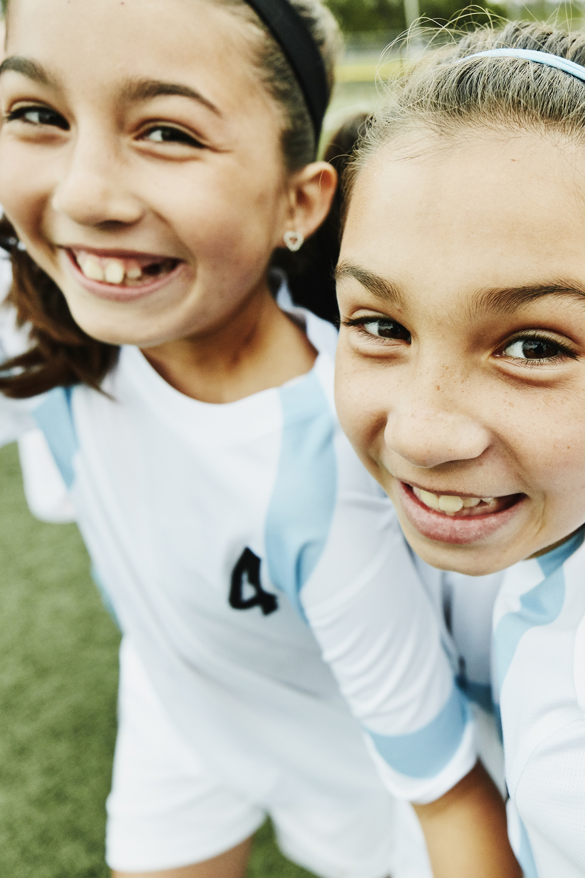
Emily spoke to her Mom about how she felt. Her Mom suggested she try to go up and talk to someone new.
So, the next day, she smiled at a girl named Amina, who was sitting by herself. Amina smiled back and Emily asked "Hi, can I sit with you today?"
Amina's eyes lit up with a big smile, and she scooted over to make room for Emily. They talked about their favourite books and movies and discovered they both loved drawing. As the days passed, Emily and Amina became fast friends, and they looked forward to lunchtime together.

Slide 8
Emily learned a valuable lesson about overcoming loneliness: sometimes, all it takes is a little courage to reach out to someone new.
And who knows, that person might just become your best lunchtime buddy, like Amina did for Emily.​

Slide 9
What could Emily and Amina's classmates do to help them feel less lonely?
Notes:
Reflect in the conversation how everyone is different

Slide 10
What helped Emily to stop feeling lonely?
Being honest about her feelings
01
Talking to someone about her feelings
02
Being brave to talk to someone new
03

Slide 11
What are some things that you do when you feel lonely?
Notes:
Reflect in the conversation how everyone is different

Slide 12

ZINES…
Make a zine telling a story about someone feeling lonely at school
How does they feel and what helps?
Story ideas:
Aaron likes something that other kids say is weird
Leah doesn't have anyone to play with at lunchtime
Simon feels left out in class

