Slide 1


Self-esteem
Self-esteem is how we think or feel about ourselves.

Slide 2
Why is self-esteem important?
When we have good self-esteem, we are more able to stay motivated, try new things, cope with problems and regulate our emotions.
Self-esteem is linked with something called self-efficacy.
Self-efficacy is a belief in what we CAN do.
Self-efficacy
Self-confidence
Self-esteem
Both of these work together to help us build SELF-CONFIDENCE.
Self-confidence is being able to trust in our feelings and skills.

Slide 3
The first step to building self-esteem is to celebrate our own uniqueness, or what makes us special.
Take out a piece of paper and something to write with…
… in 2 minutes, write down as many ways that people are different from each other...

Slide 4
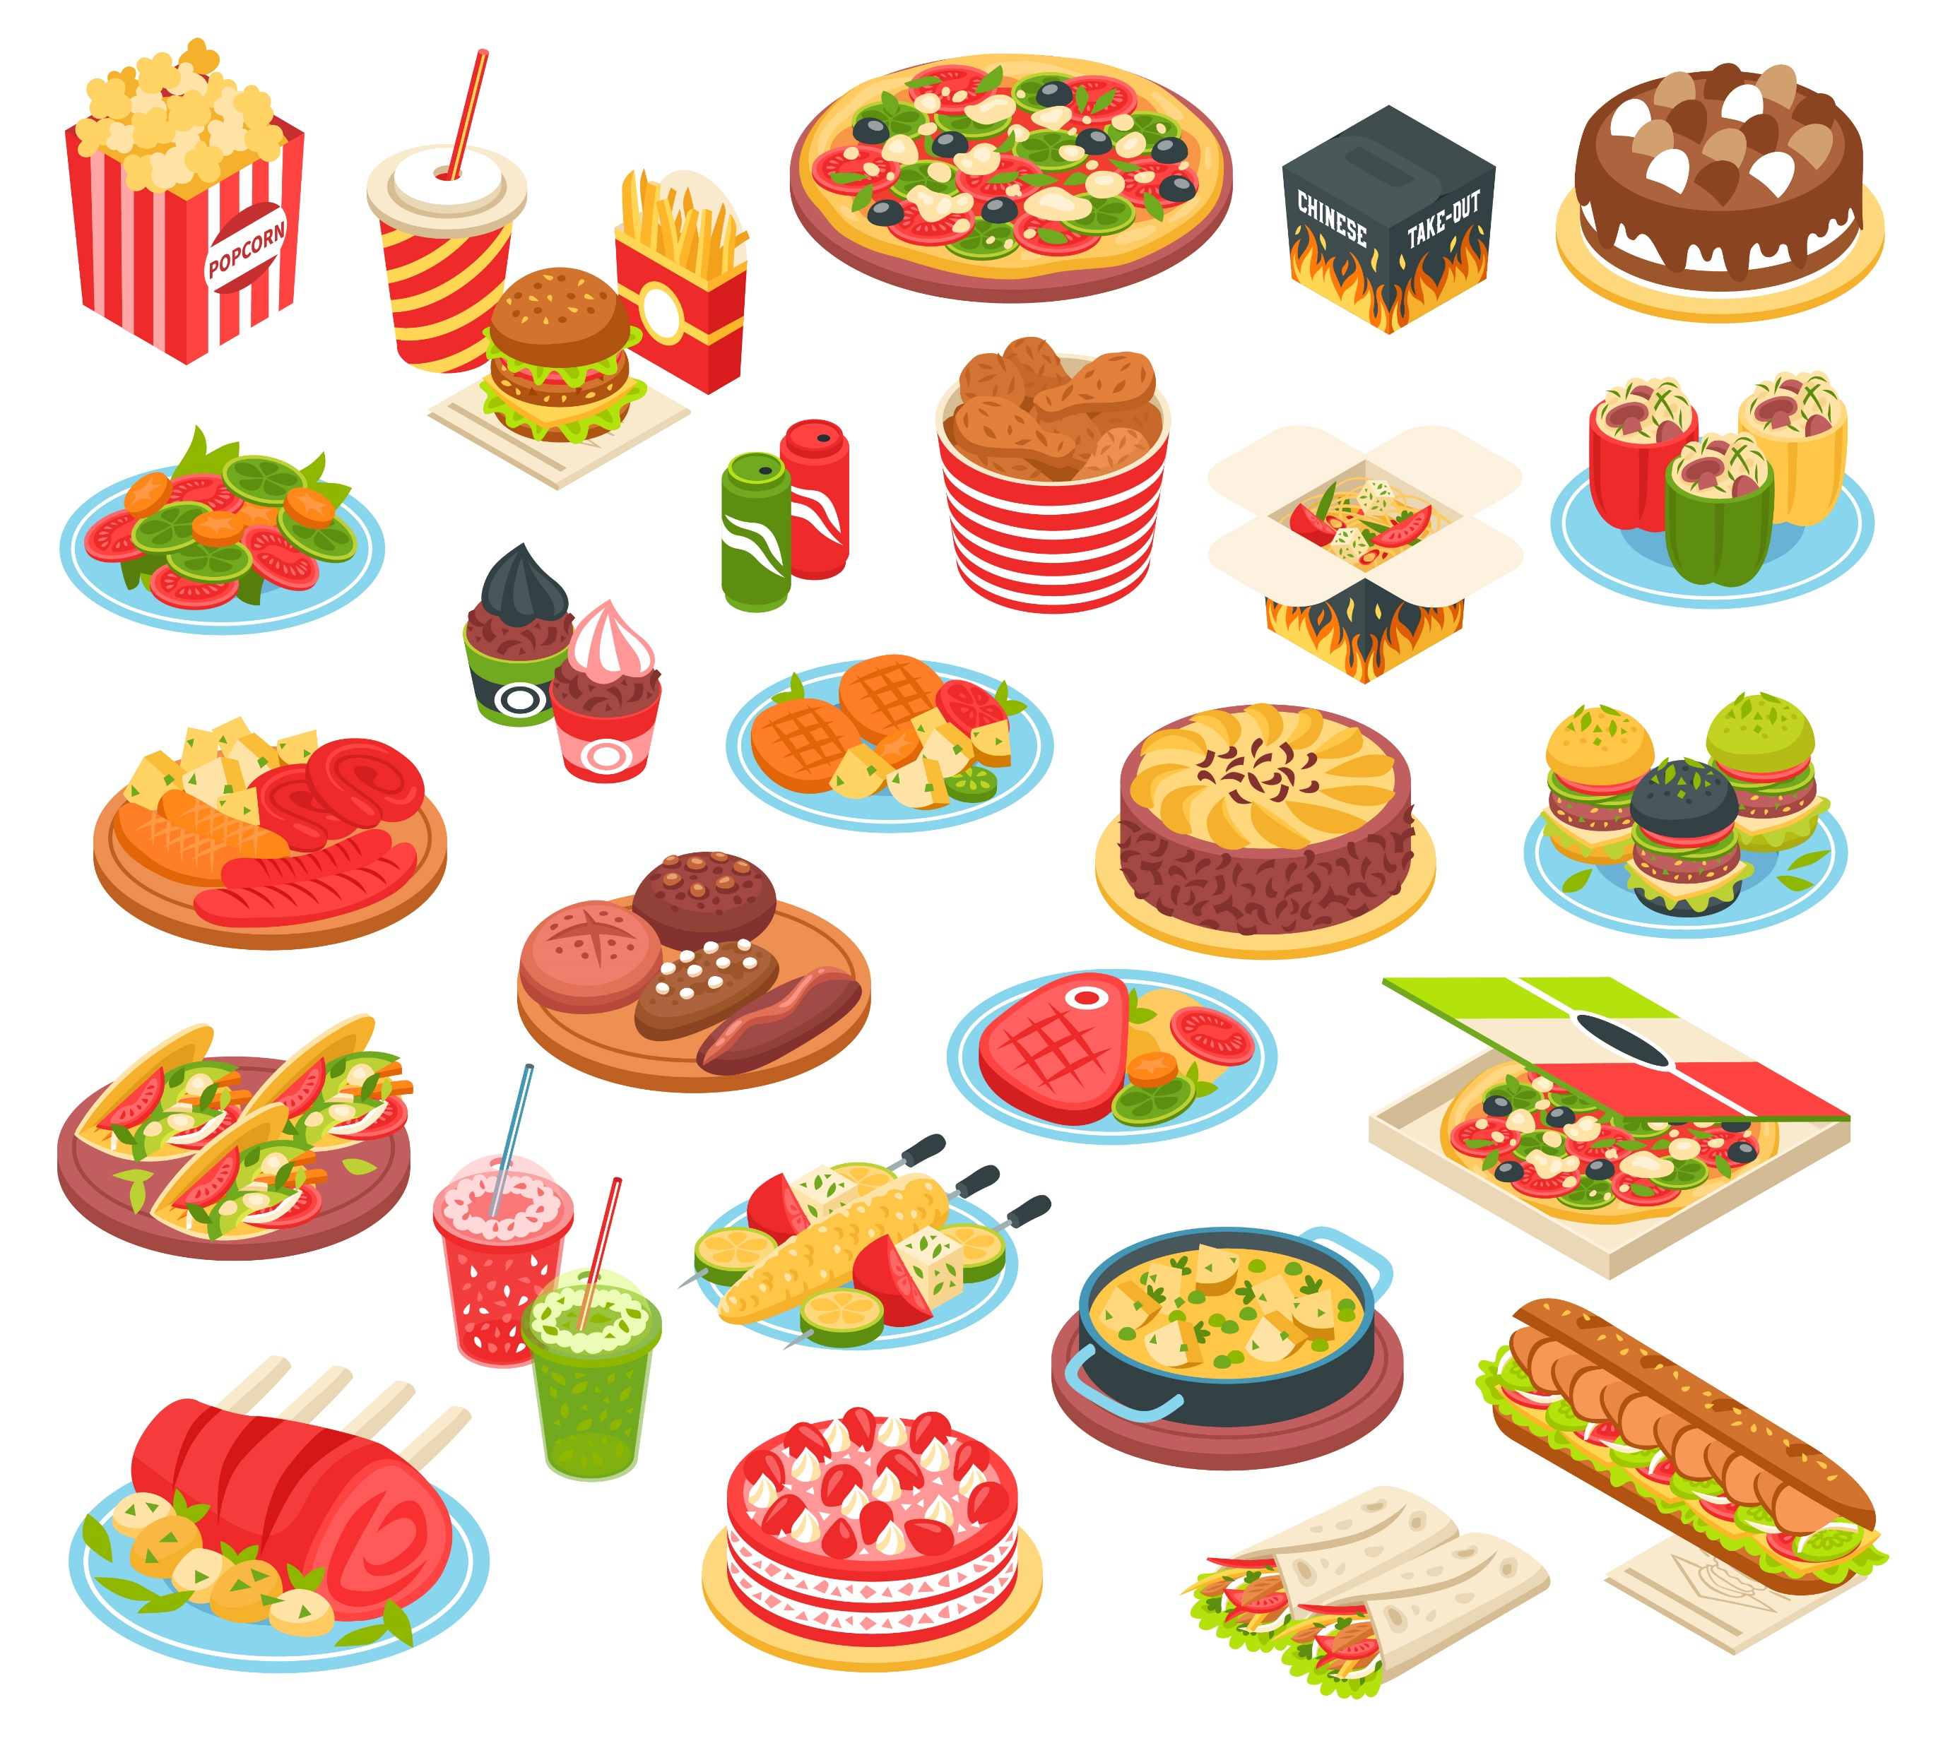
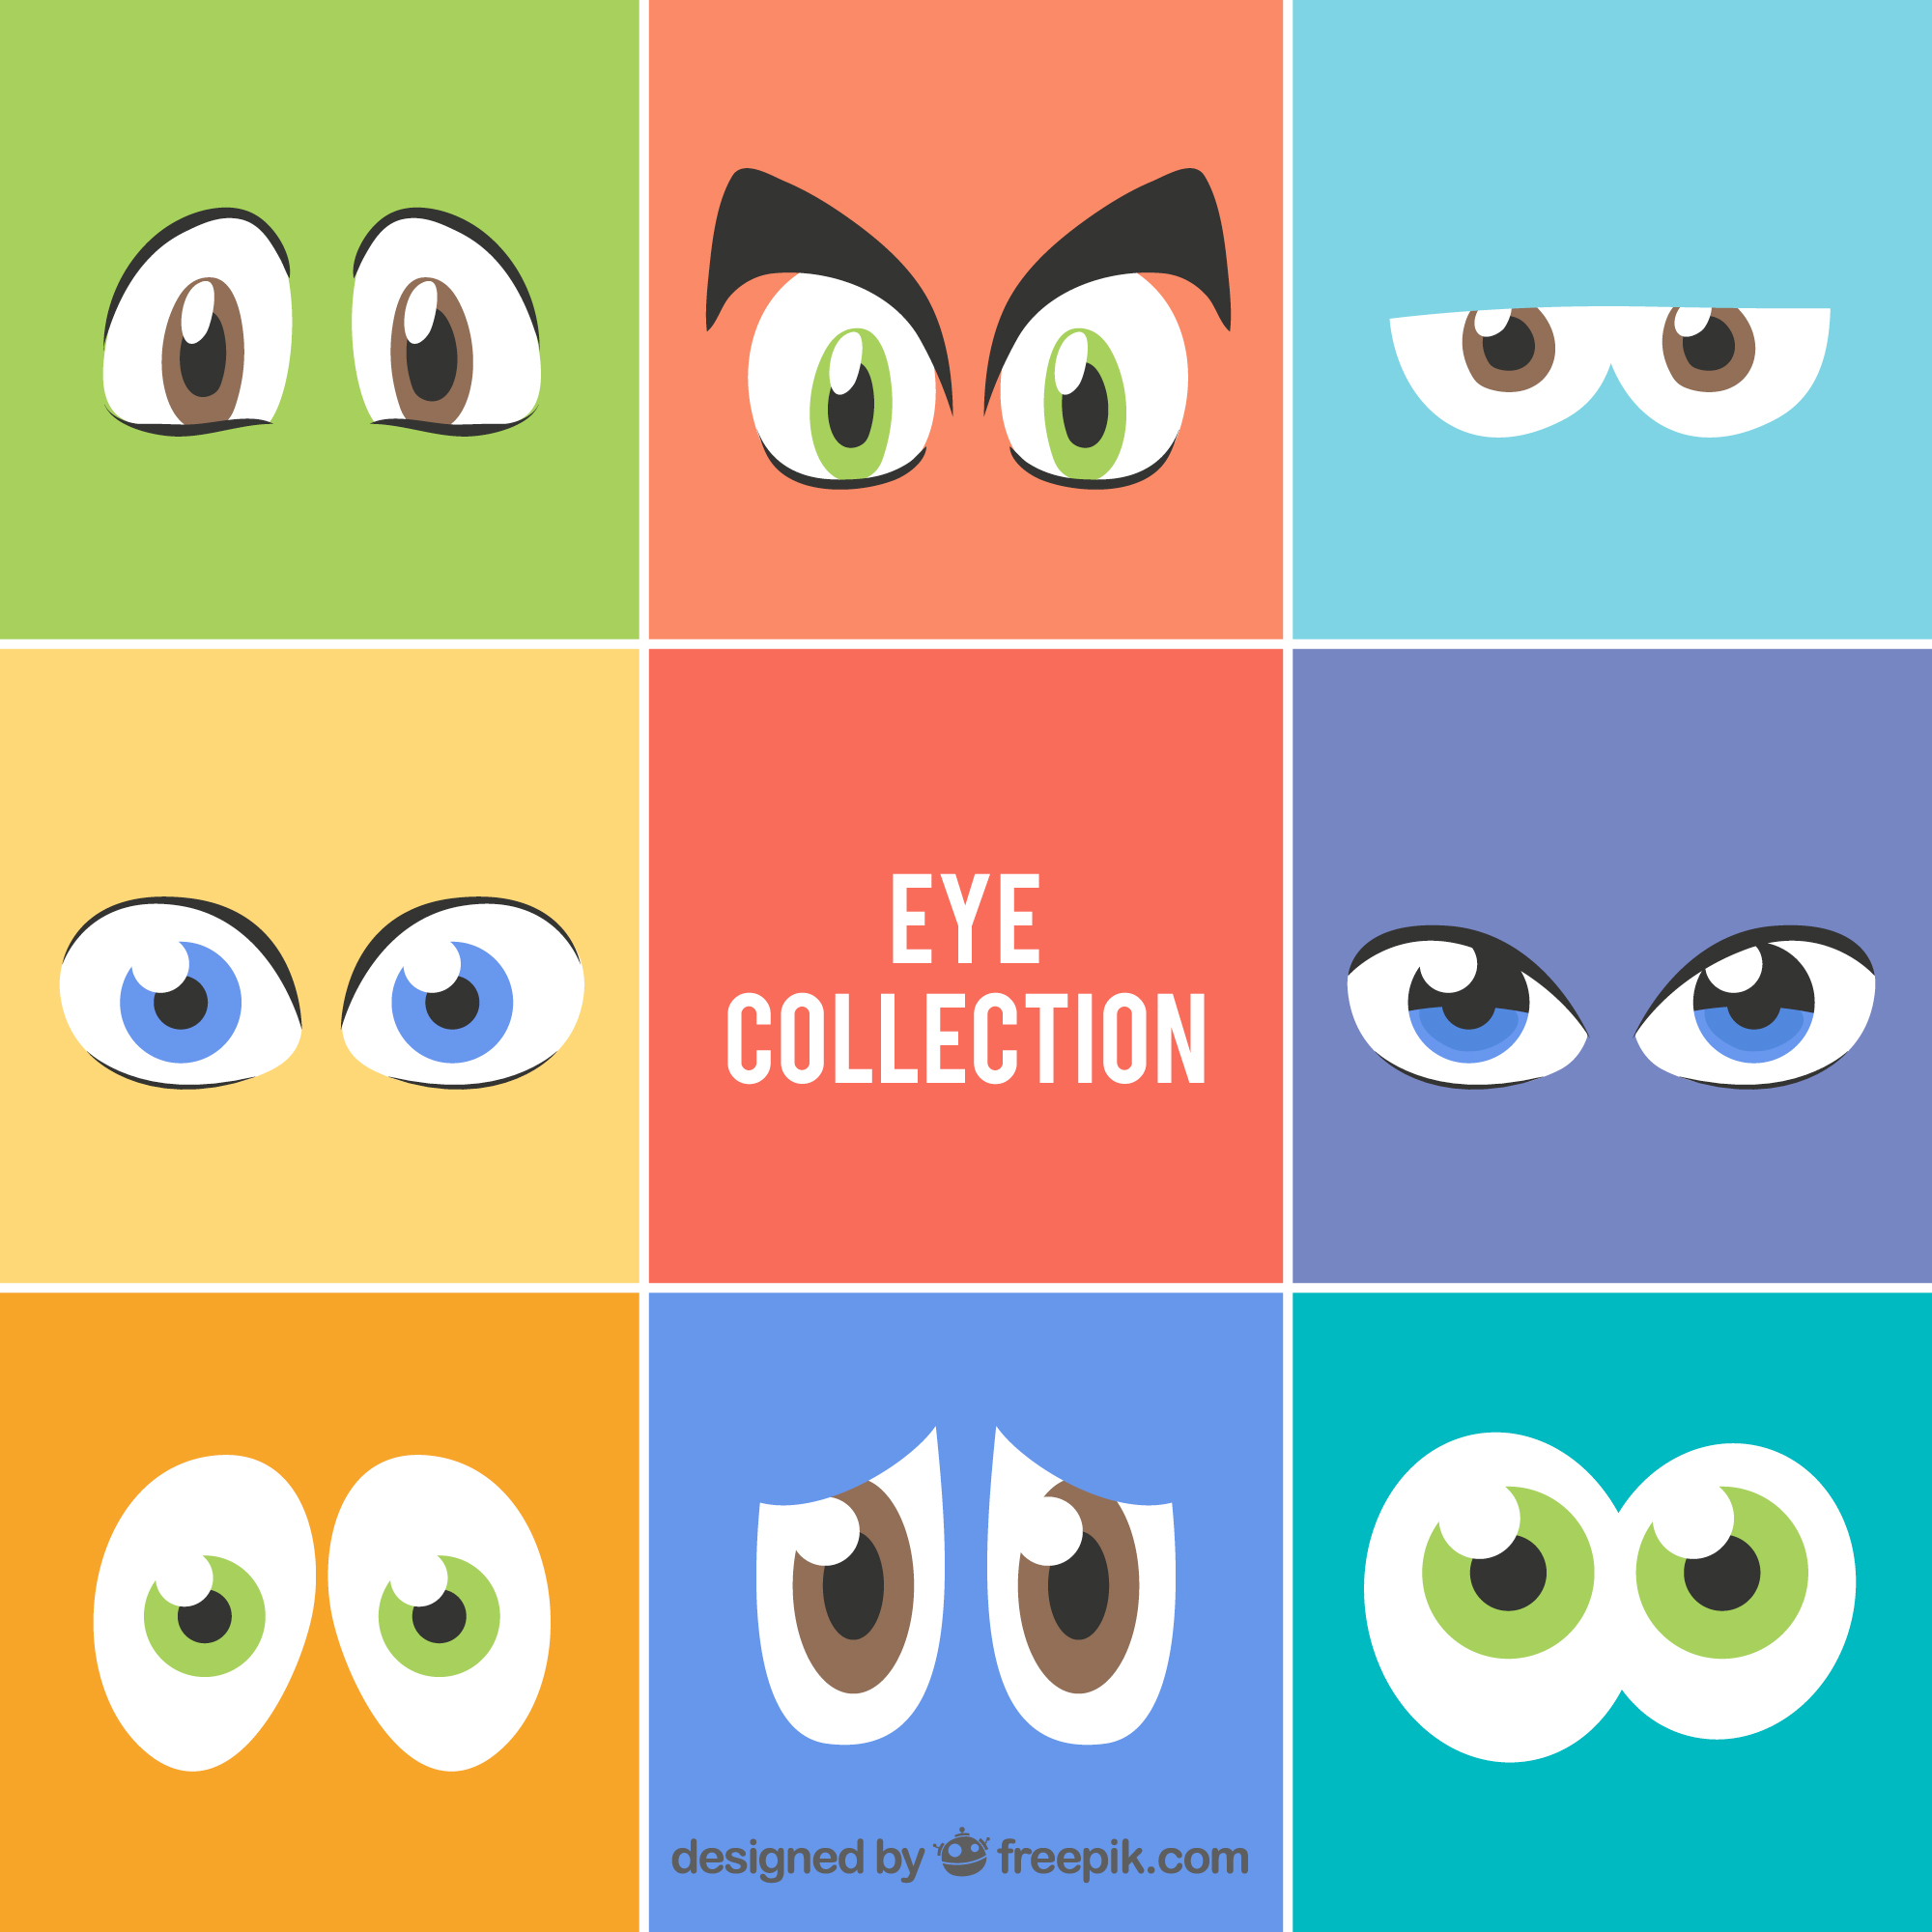
How many did you list?
Did these include physical differences like eye colour and height?
Did they include non-physical differences like type of music we like and our favourite food?
Notes:
Image by Freepik

Slide 5
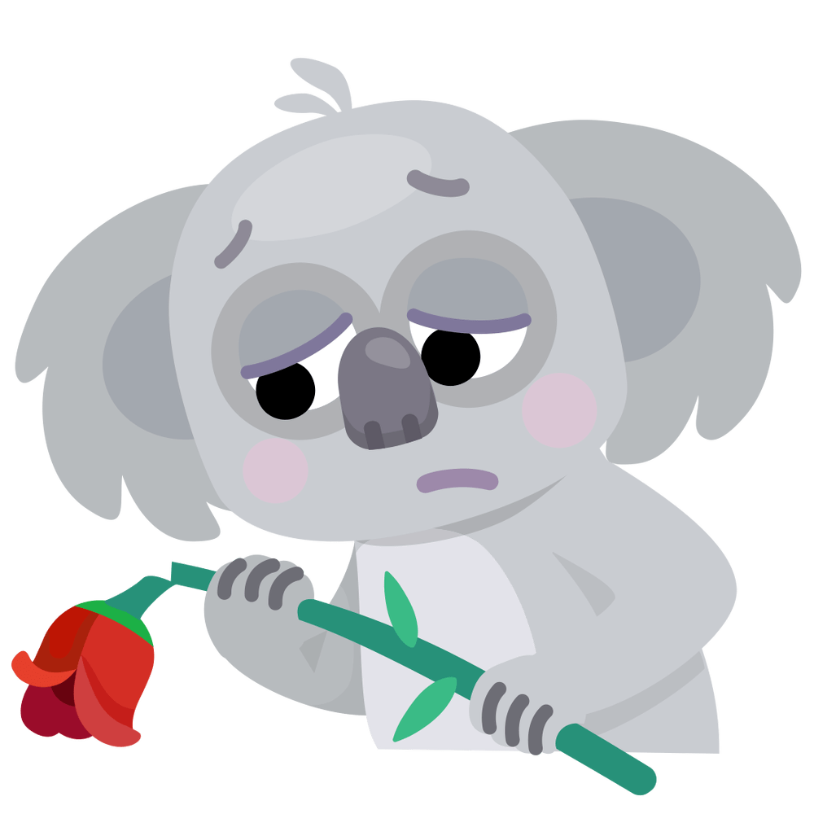
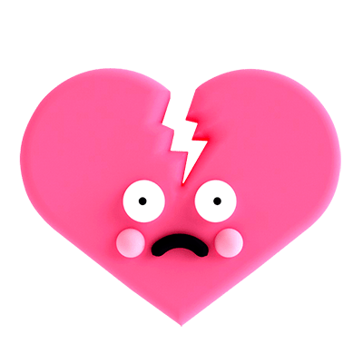
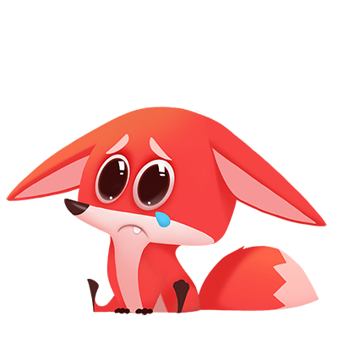
What happens when we have low self-esteem?
What kind of things might cause us to not like things about ourselves?
What feelings might we have if we don't like something about ourselves?
Notes:
Image by Freepik

Slide 6
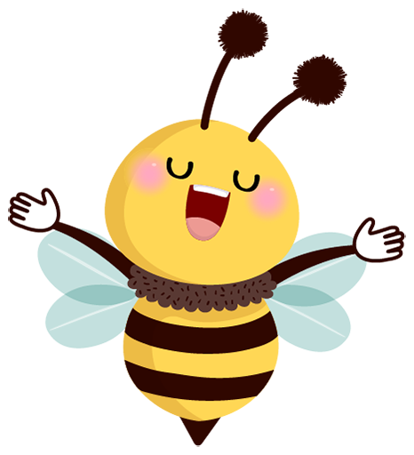
What things could we do to build up our self-esteem?
Write a list of our talents and the good things about us
Do an activity you enjoy
Do some breathing exercises
Talk to a parent, friend or teacher about our feelings
Do some exercise

Slide 7

ZINES…
Make a zine showing 2 things you like about yourself, 2 things that you are good at and 1 thing that makes you special...
Some prompts to get you started:
My friends think I’m awesome because…
My classmates say I’m great at…
I feel very happy when I…
Something that I’m really proud of is…
I make my family happy when I…
One unique thing about me is…

Slide 8
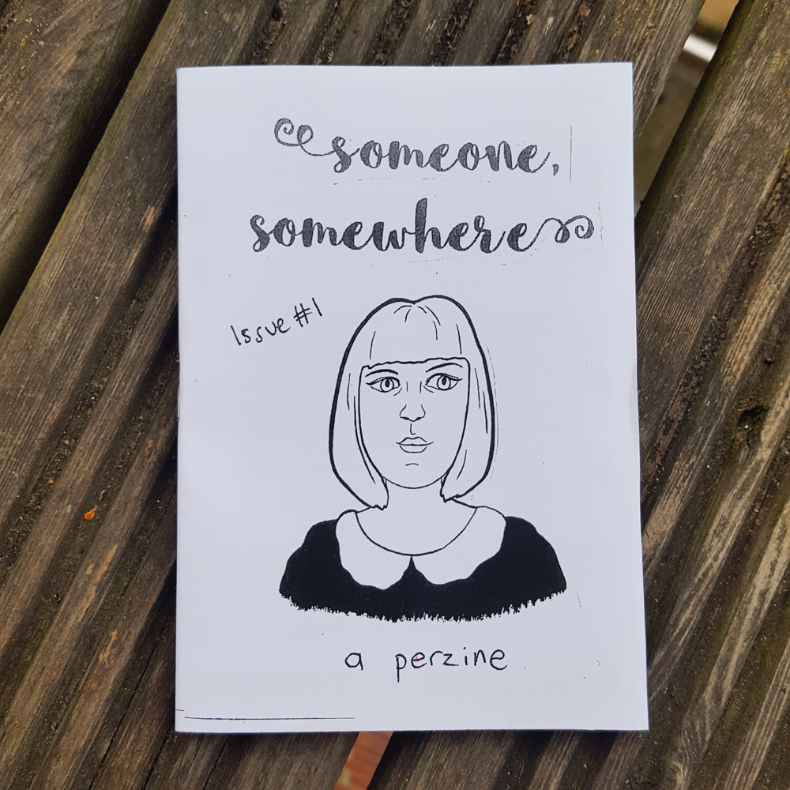
Perzine...
Perzines are a genre of zines; the "per" meaning "personal".
A perzine usually:
Include work of one person
are written about one's own personal experiences, Opinions and observations
Can include drawings, writing, collage, photographs, comics or any other art form!

Slide 9
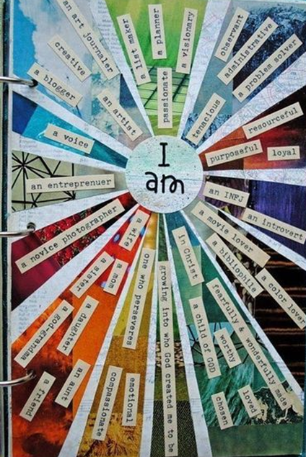
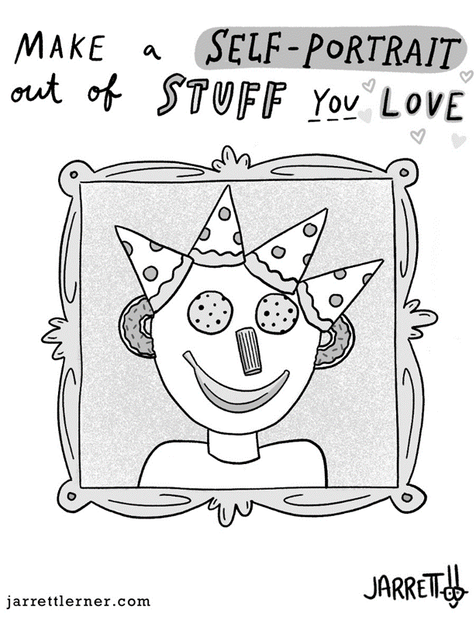
Here are some things that could be included in your perzine about yourself...
  What am I good at?
  Lots of things! So many things!
  Loads to celebrate!
A poem
A collage
Can you use some of these in your zine today?
A drawing

