Slide 1



Healthy Sleep

Slide 2
Who we are
Mental Health Support Team
Our job is to help children and young people with their thoughts, feelings and emotions.
We support young people in school through 1-1 work, group work, workshops and assemblies.
Notes:
Please edit this slide depending on who is delivering the workshop.

Slide 3


Who do you think needs the most sleep?
Cats need 12.5 hours
Elephants need 3 hours
Notes:
Hands up who thinks it is the cat and hands up who thinks it is the elephant
The large the animal, the less sleep is needed.
This is similar for most mammals. The general rule is that the larger the mammal the less sleep they need. One reason this might be is because larger animals need to eat more food so need to spend longer awake looking for or hunting the food.

Slide 4
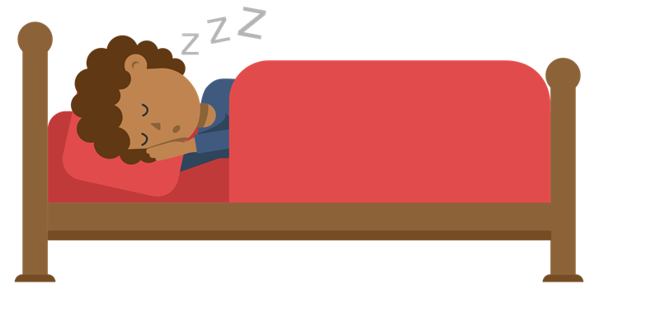
Why do we need sleep?
To sort our memories
It’s as important as food and water
To repair our bodies
Give us energy to enjoy our days
Stop us getting ill
Notes:
Growth hormone – aids your child to grow and develop, it aids your brain to recover from your day
Melatonin is a hormone in your brain and helps your body when its time to sleep and wake up. The hormone is released at night
Allows your brain to store your memories and make space for new memories and allows your body to rest ready for a new day of exercise. It also allows your body to repair itself from any injuries that you have got
Helps you to stay alert and have the ability to learn
Helps you to perform effectively and safely throughout your day
Prevents illnesses

Slide 5
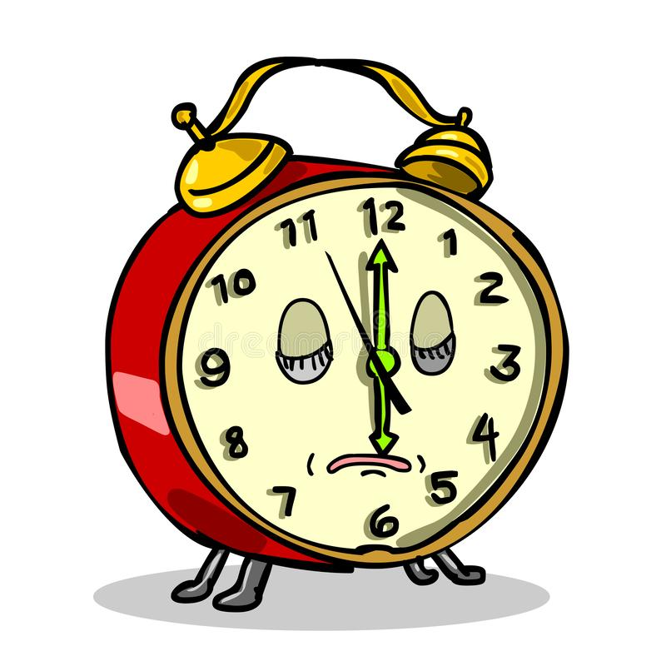
How much sleep do you think you need?
Notes:
Ask the question – 3 options with interactive answers e.g. hands on shoulders, hands on head?
5 hours – put your hands on your hips
8 hours – put your hands on your shoulders
10 hours – put your hands on your head

Slide 6
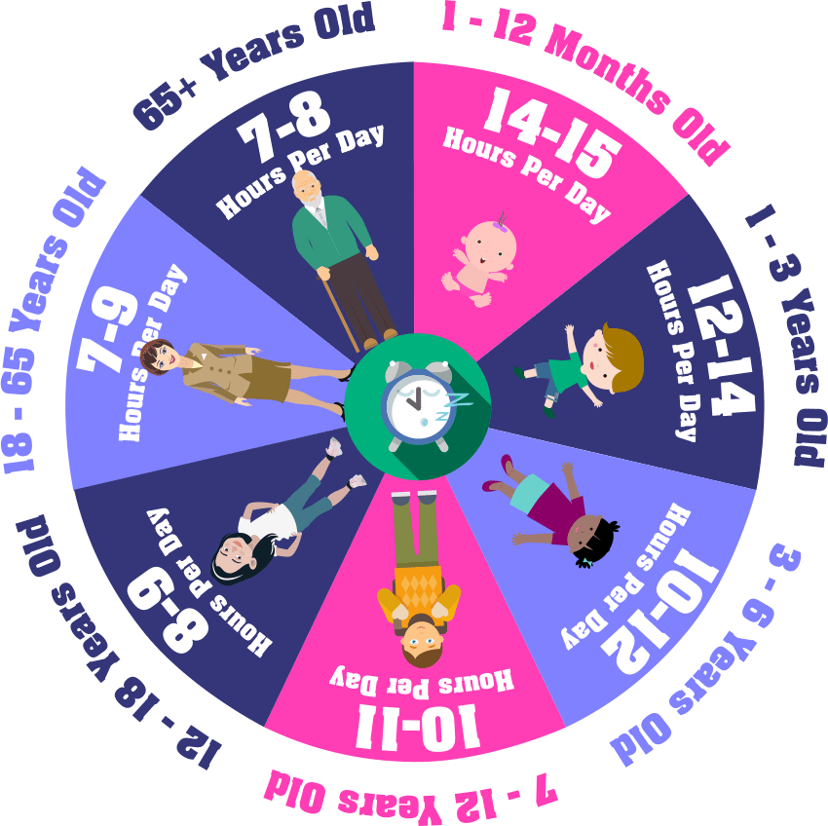

Slide 7

True or false?
Notes:
Get children to stand up (true) sit down (false), OR point to the Door (true) or windows (false). Immediately give the answers
No because our body thinks the light from the phone is sunlight which tricks us into thinking it is day time. This can make it hard for you to switch off and go to sleep
No because they have caffeine and sugar in them which both give you energy and make you feel more awake
Yes because if your bedroom is too warm your body becomes too warm and this can make getting to sleep more difficult. This can be a problem during summer especially during heat waves
Yes this is important because we naturally sleep at night when it is dark so the darkness tells our brain and body it is time to rest
No because eating a large meal can make us feel uncomfortable and this can make it harder to relax and fall asleep

Slide 8
It’s good to play video games or watch television before bed
FALSE
Notes:
Get children to stand up (true) sit down (false), OR point to the Door (true) or windows (false). Immediately give the answers
No because our body thinks the light from the phone is sunlight which tricks us into thinking it is day time. This can make it hard for you to switch off and go to sleep
No because they have caffeine and sugar in them which both give you energy and make you feel more awake
Yes because if your bedroom is too warm your body becomes too warm and this can make getting to sleep more difficult. This can be a problem during summer especially during heat waves
Yes this is important because we naturally sleep at night when it is dark so the darkness tells our brain and body it is time to rest
No because eating a large meal can make us feel uncomfortable and this can make it harder to relax and fall asleep

Slide 9
It is good to have energy drinks before bed to help me sleep
FALSE
Notes:
Get children to stand up (true) sit down (false), OR point to the Door (true) or windows (false). Immediately give the answers
No because our body thinks the light from the phone is sunlight which tricks us into thinking it is day time. This can make it hard for you to switch off and go to sleep
No because they have caffeine and sugar in them which both give you energy and make you feel more awake
Yes because if your bedroom is too warm your body becomes too warm and this can make getting to sleep more difficult. This can be a problem during summer especially during heat waves
Yes this is important because we naturally sleep at night when it is dark so the darkness tells our brain and body it is time to rest
No because eating a large meal can make us feel uncomfortable and this can make it harder to relax and fall asleep

Slide 10
My bedroom should be kept at a cool, comfortable temperature
TRUE
Notes:
Get children to stand up (true) sit down (false), OR point to the Door (true) or windows (false). Immediately give the answers
No because our body thinks the light from the phone is sunlight which tricks us into thinking it is day time. This can make it hard for you to switch off and go to sleep
No because they have caffeine and sugar in them which both give you energy and make you feel more awake
Yes because if your bedroom is too warm your body becomes too warm and this can make getting to sleep more difficult. This can be a problem during summer especially during heat waves
Yes this is important because we naturally sleep at night when it is dark so the darkness tells our brain and body it is time to rest
No because eating a large meal can make us feel uncomfortable and this can make it harder to relax and fall asleep

Slide 11
My bedroom should be dark
TRUE
Notes:
Get children to stand up (true) sit down (false), OR point to the Door (true) or windows (false). Immediately give the answers
No because our body thinks the light from the phone is sunlight which tricks us into thinking it is day time. This can make it hard for you to switch off and go to sleep
No because they have caffeine and sugar in them which both give you energy and make you feel more awake
Yes because if your bedroom is too warm your body becomes too warm and this can make getting to sleep more difficult. This can be a problem during summer especially during heat waves
Yes this is important because we naturally sleep at night when it is dark so the darkness tells our brain and body it is time to rest
No because eating a large meal can make us feel uncomfortable and this can make it harder to relax and fall asleep

Slide 12
Eating a large meal before bed will help me sleep better
FALSE
Notes:
Get children to stand up (true) sit down (false), OR point to the Door (true) or windows (false). Immediately give the answers
No because our body thinks the light from the phone is sunlight which tricks us into thinking it is day time. This can make it hard for you to switch off and go to sleep
No because they have caffeine and sugar in them which both give you energy and make you feel more awake
Yes because if your bedroom is too warm your body becomes too warm and this can make getting to sleep more difficult. This can be a problem during summer especially during heat waves
Yes this is important because we naturally sleep at night when it is dark so the darkness tells our brain and body it is time to rest
No because eating a large meal can make us feel uncomfortable and this can make it harder to relax and fall asleep

Slide 13
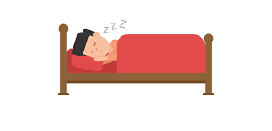
How can we sleep better?
Notes:
Take a few suggestions from students (depending on engagement)

Slide 14





Bedroom Box
Drawing
Puzzles
Cutting and Sticking
Reading
Notes:
Bedtime box – activities to carry out during bedtime routine to help wind down
Colouring, puzzles, jigsaws, cutting and sticking, drawing, night time snack
The example shows things you could put in your box. Think about your 5 senses and how to calm these down e.g. a soft toy or stress ball, lavender or other relaxing scents, your favourite book
Think of 3 things you would put in your box

Slide 15
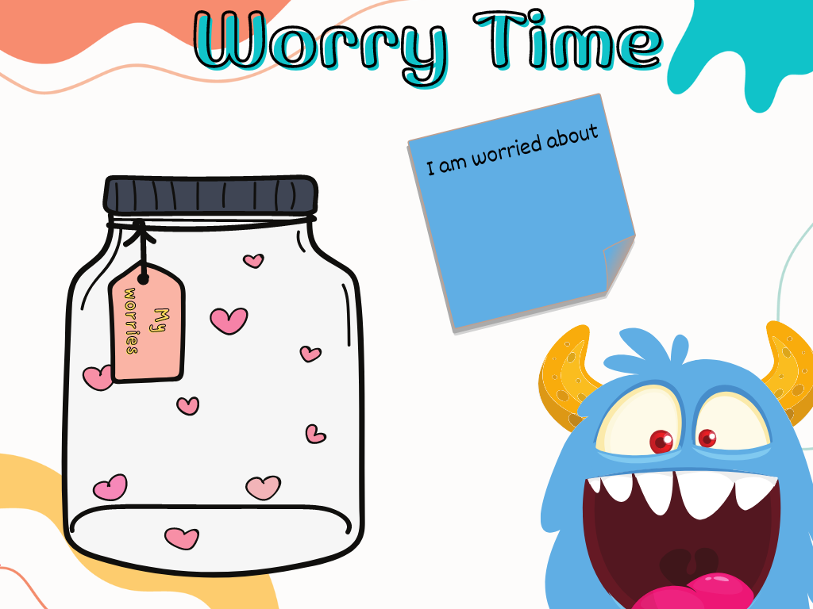
Worry Time
If you find you are worrying a lot before bed and this is affecting your sleep you could try Worry Time or use a worry monster.
Notes:
Worry time: if you find you are worrying a lot before bed and this is affecting your sleep you could try Worry Time
During the day if you find yourself worrying about something, write it down in a notebook/pop it in a box
Find a time in the evening with an adult at home to go through each of these worries and talk through them

Slide 16

Breathing Techniques
Notes:
https://youtu.be/0t8f_f9OoM0 Puffer fish breathing techniques.
Reduces stress
Lower tension in our muscles
Reduces heartbeat
Leads to greater feelings of happiness in general

Slide 17


