Slide 1


Anger
What should we do when we feel angry?

Slide 2
What kinds of things make us angry?
What emotional zone are we in when we get angry?

Slide 3
Blue Zone
Green Zone
low or ‘down’ feelings
calm feelings
Happy – Focused – Content
Proud - Ready to learn
Sad - Tired - Sick - Bored
Yellow Zone
Red Zone
slightly elevated feelings
extreme feelings
Worry – Frustrated – Silly
Excited - Stress
Overjoyed – Panicked – Anger
Terrified - Devastated

Slide 4
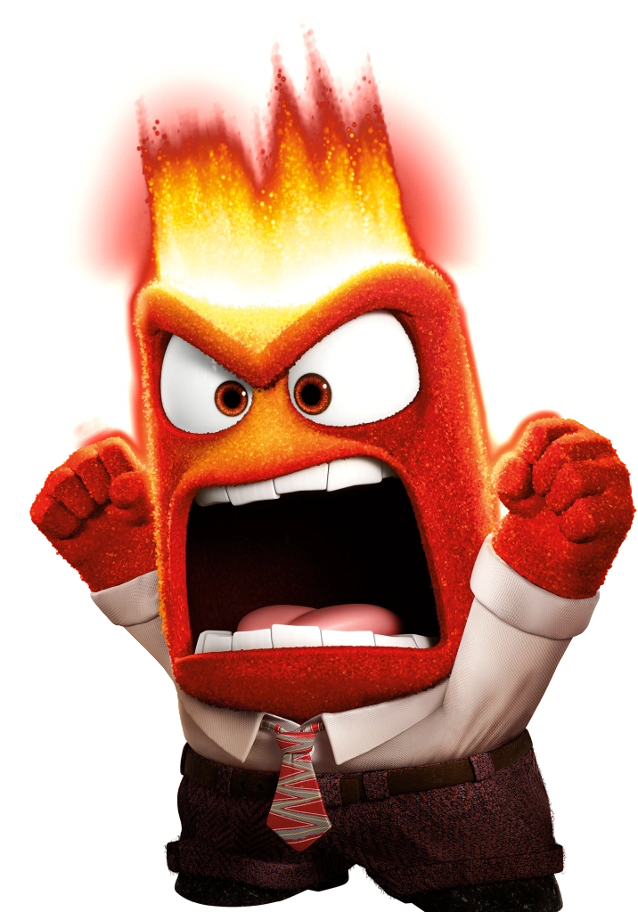
Think about a time when you've felt angry at school...
write down what you felt in your body when this happened...

Slide 5
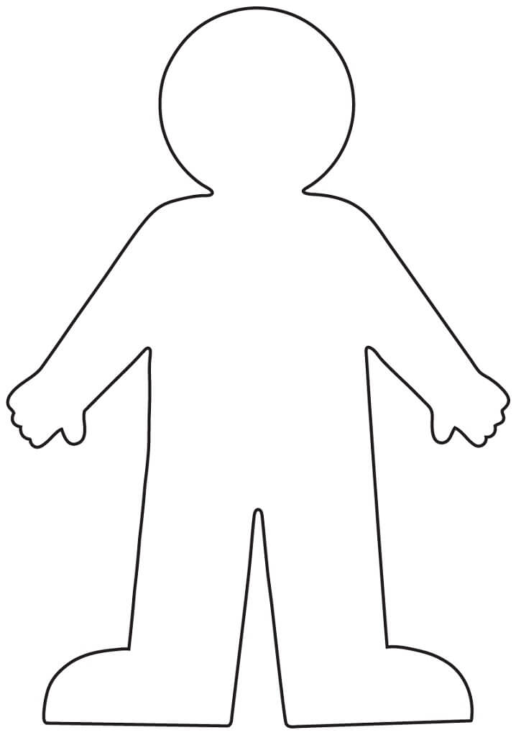
What happens in your body when you feel angry?
Make mean comments
Raise your voice
Heart racing
Body feels hot and shaky
Kick things
Hit or throw things

Slide 6
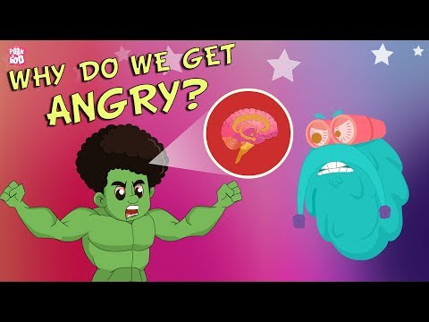
Why do we get angry?

Slide 7
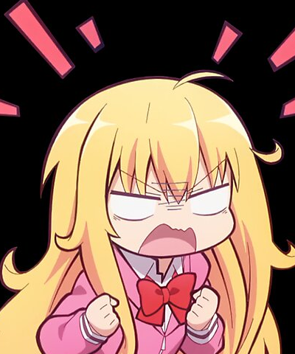
What did we learn about anger from the video?

Slide 8
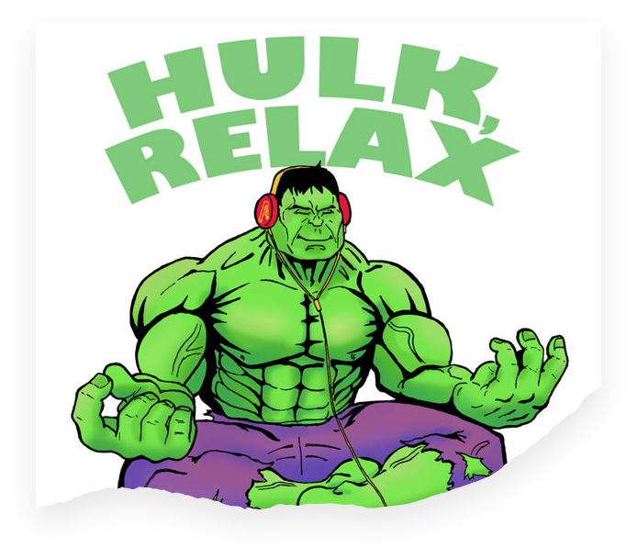
What can we do to make sure we don't hurt ourselves or others when we are angry?
  Take deep breaths
  Exercise
  Tell someone how we're feeling
  Take a break

Slide 9
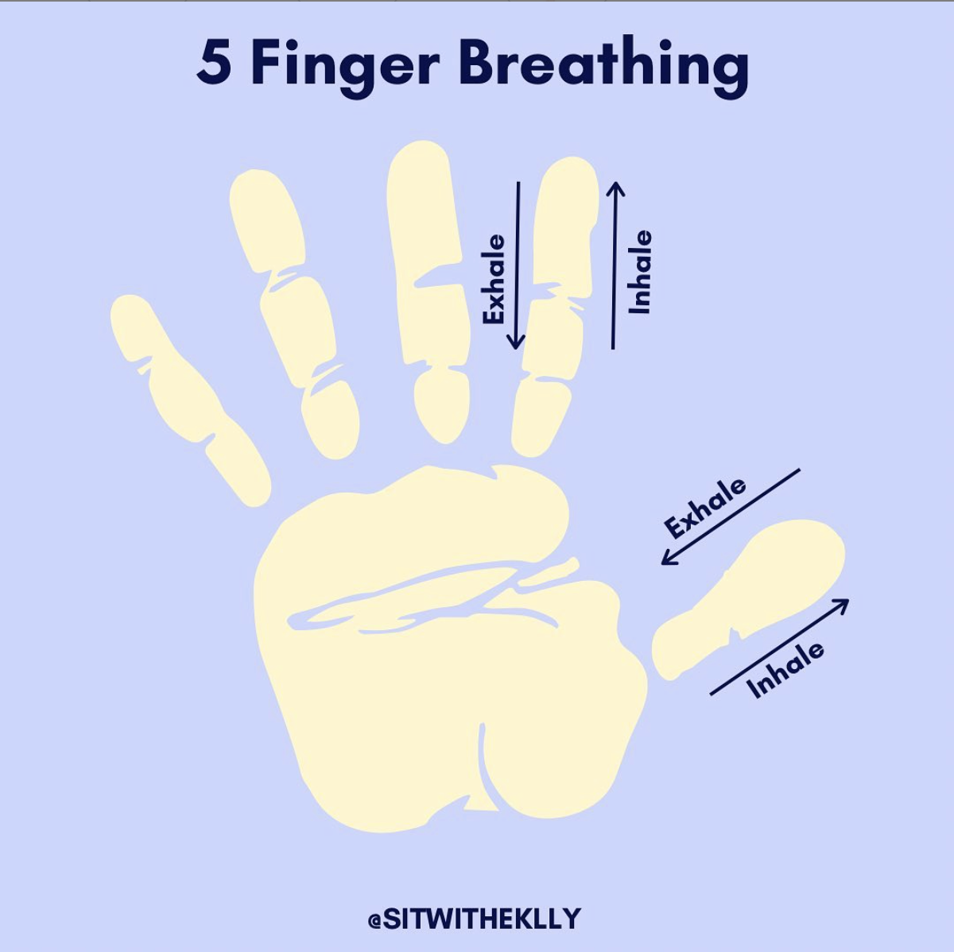
Let's try a breathing exercise together

Slide 10
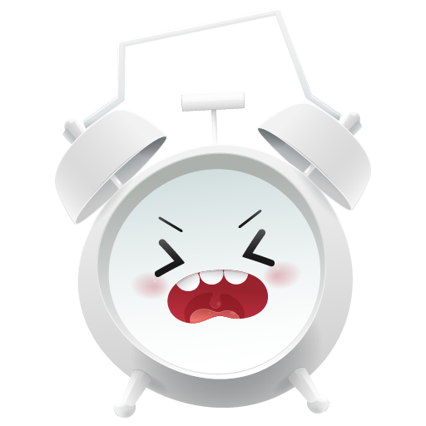
ZINES…
Make a zine telling us which parts of the body get activated when you're angry and what you can do help calm you down
On each page, tell us about a different body part:
When I get angry my head...
When I get angry my chest...
When I get angry I can do....

